Slide 1
On the Need of Computing in Future Communication Networks
Chapter 1
Computing on Communication Networks Fitzek/Granelli/Seeling
Frank H.P. Fitzek, Patrick Seeling, Thomas Höschele, and Bruno Jacobfeuerborn

Slide 2
Evolution of Communication Networks

Slide 3
The evolution of telephone network architectures

Slide 4
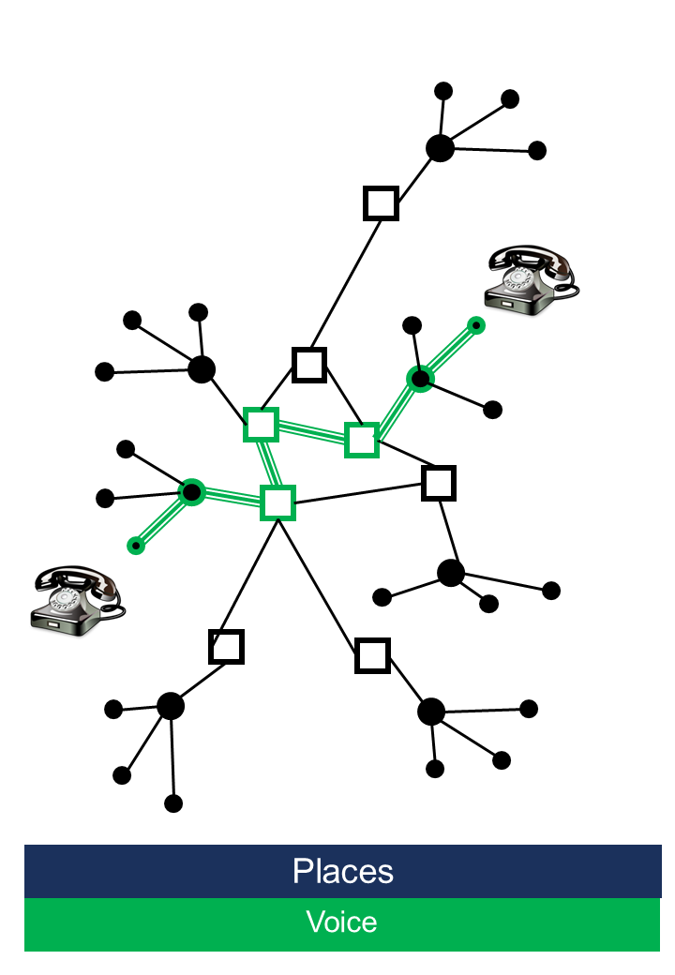
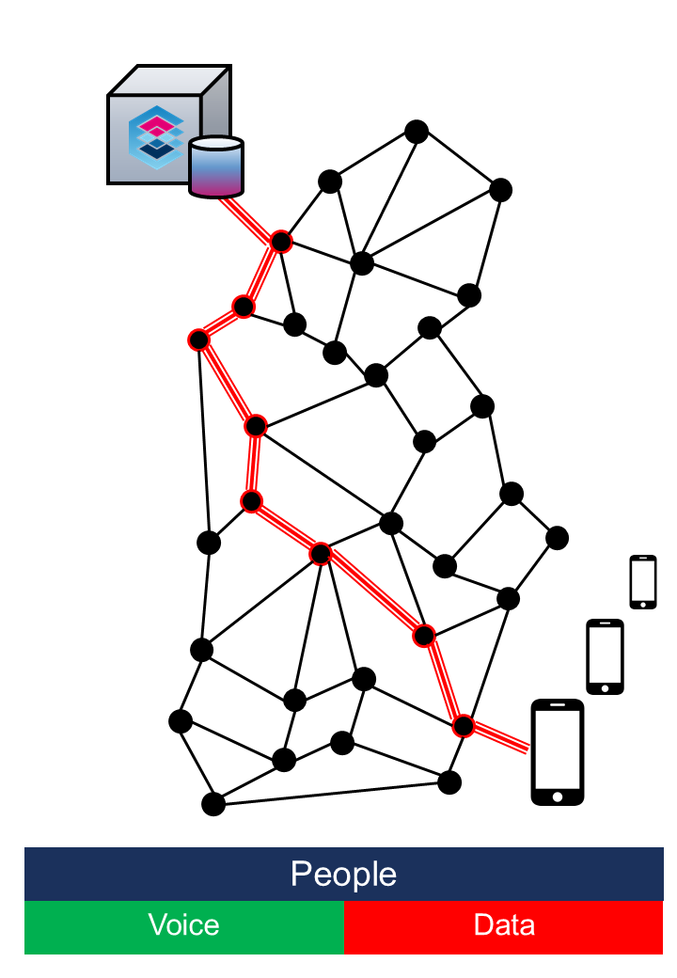
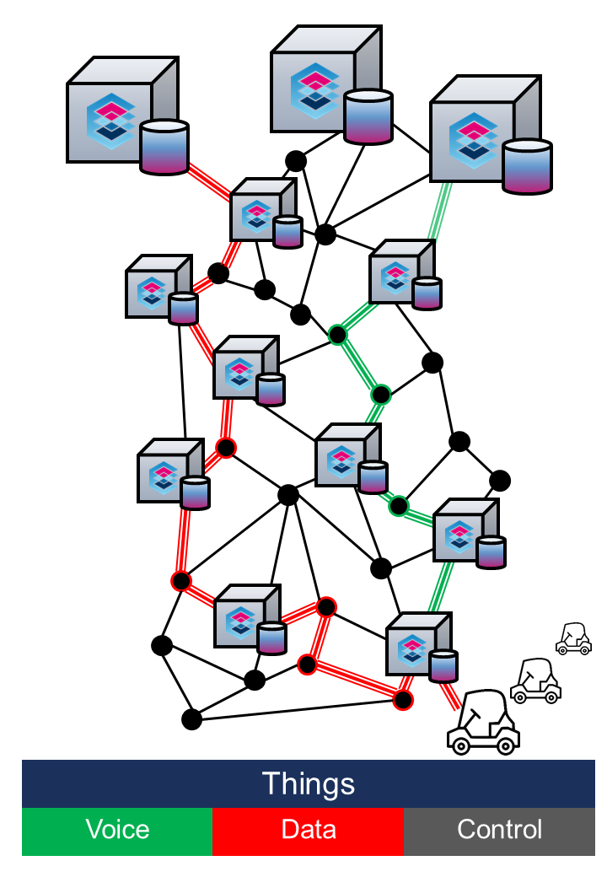
The evolution of communication architectures

Slide 5
The evolution of cellular communication systems

Slide 6
The 5G Communication System

Slide 7
The 5G Atom

Slide 8
The 5G Atom use cases: Connected autonomous cars platooning example

Slide 9
The 5G Atom use cases: Connected autonomous cars crossing scenario

Slide 10
The 5G Atom use cases: Connected autonomous cars Barcelona example

Slide 11
The 5G Atom use cases: Example network architecture in Industry 4.0

Slide 12
The 5G Atom use cases: Industry 4.0 training or remote control of robots in a virtual room

Slide 13
The 5G Atom use cases: Agriculture 4.0 machinery platooning with small machines

Slide 14
The 5G Atom use cases: Virtual power plant model for the smart energy grid

Slide 15
The 5G Atom use cases: Tactile Internet

Slide 16
5G Atom: Technical requirements - latency

Slide 17
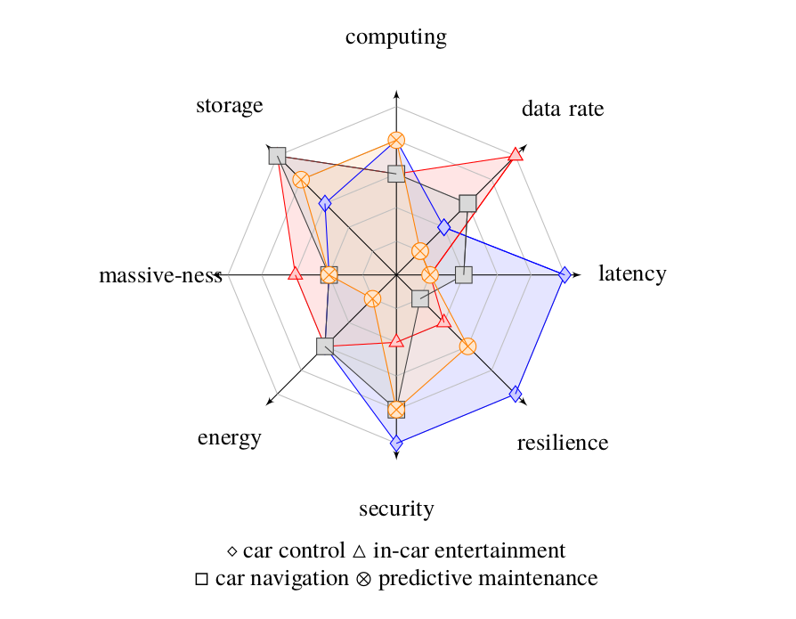
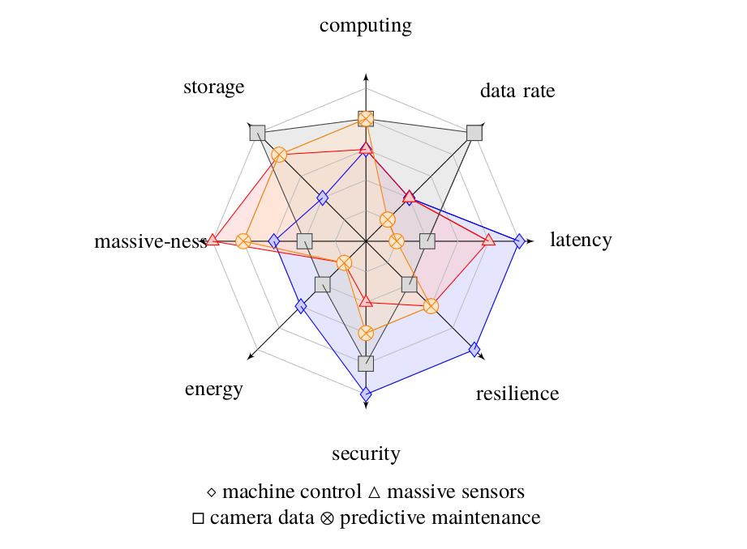
5G Atom technical parameters and use cases

Slide 18
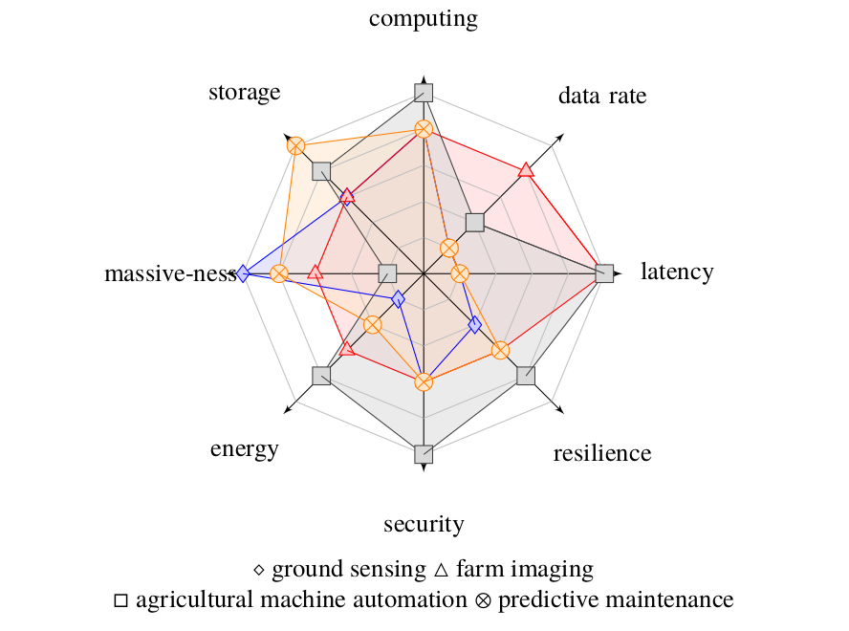
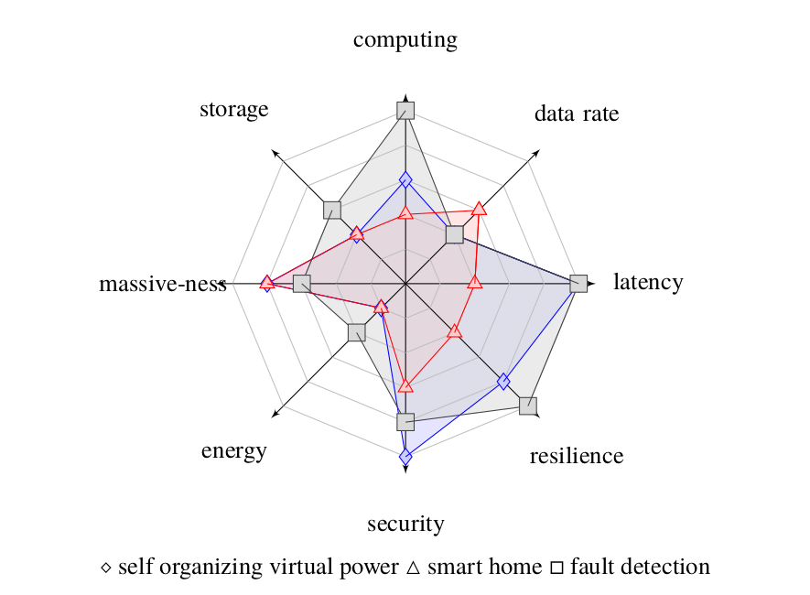
5G Atom technical parameters and use cases

Slide 19
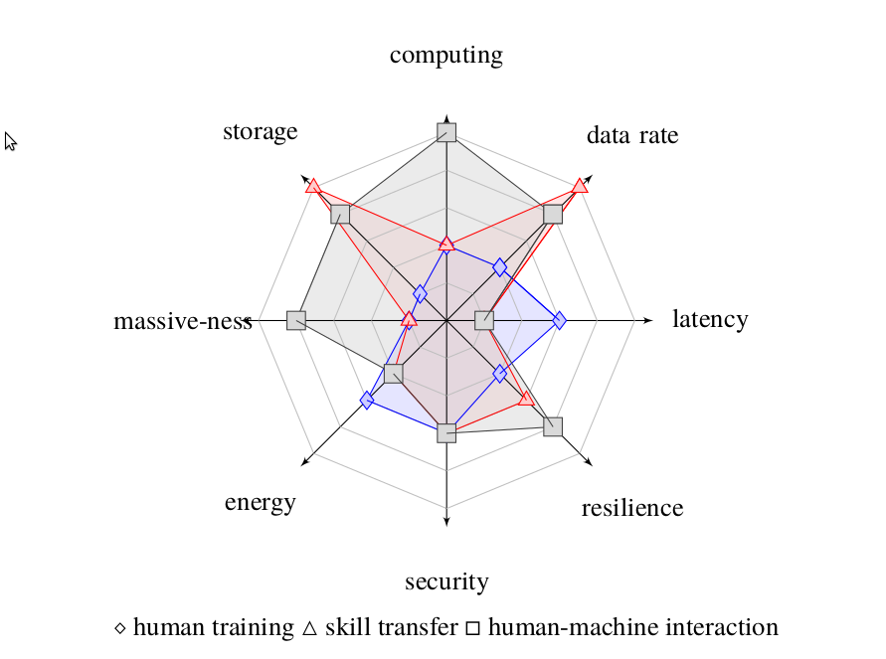
5G Atom technical parameters and use cases

Slide 20
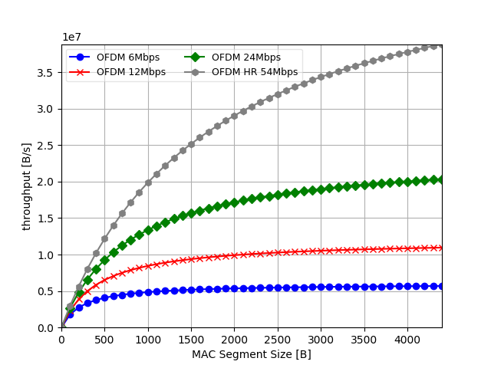
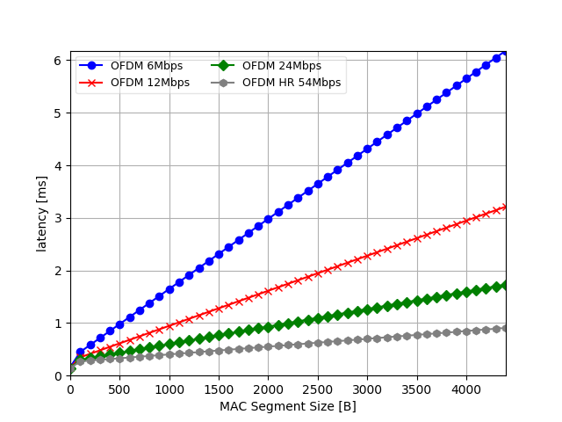
The 5G Atom concepts: The trade-off between throughput and latency

Slide 21
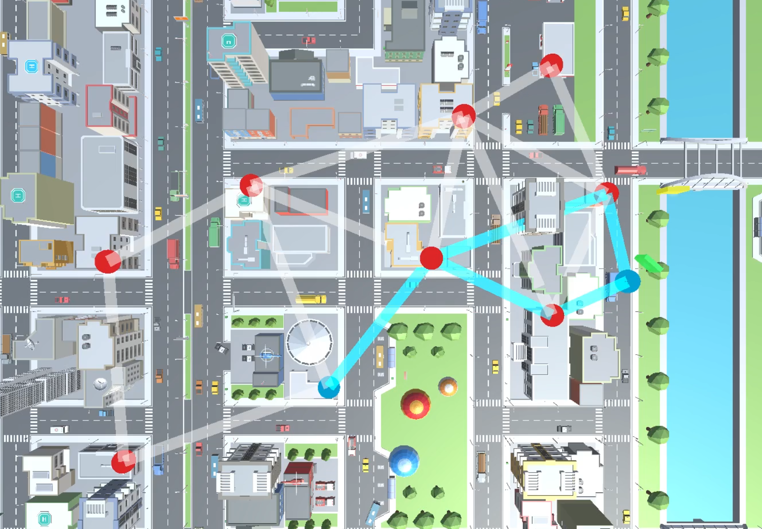
The 5G Atom concepts: Meshmerize (multi-path) vs. B.A.T.M.A.N. (single-path) demonstrator

Slide 22
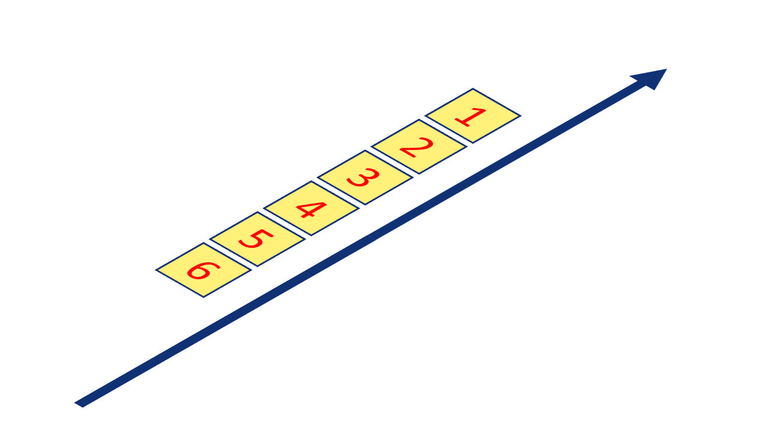
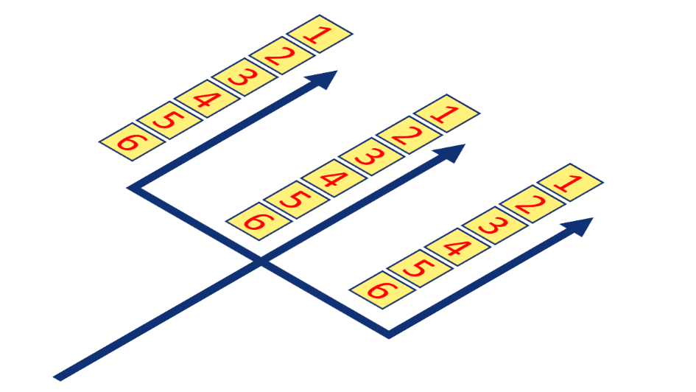
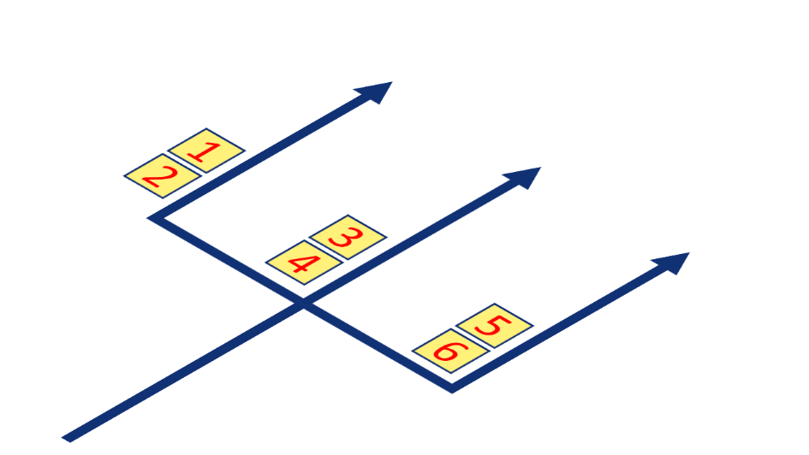
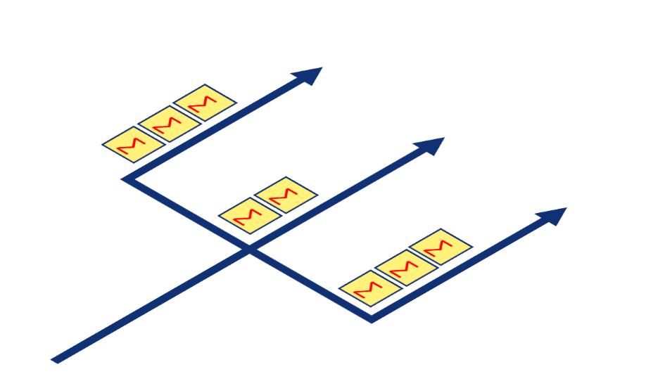
The 5G Atom concepts: Multi-path examples conveying six packets

Slide 23
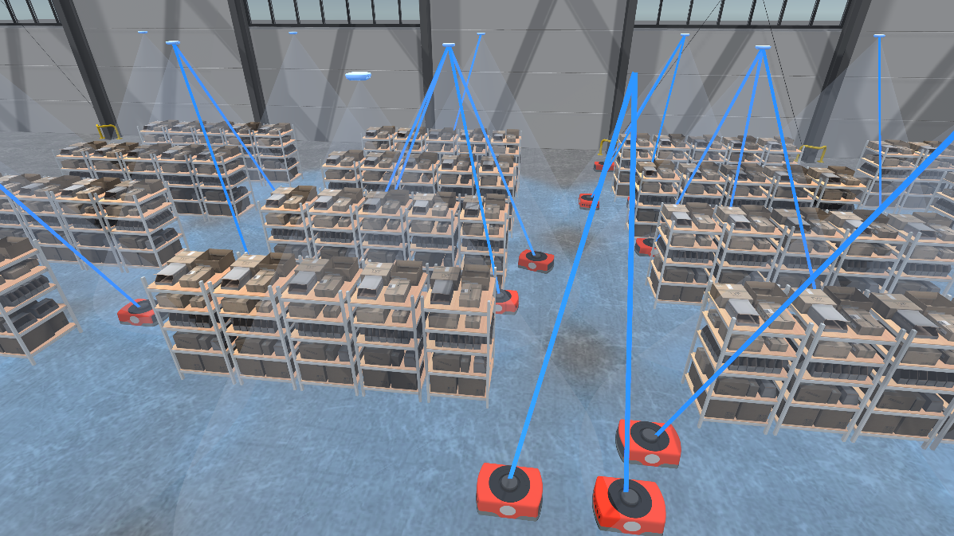
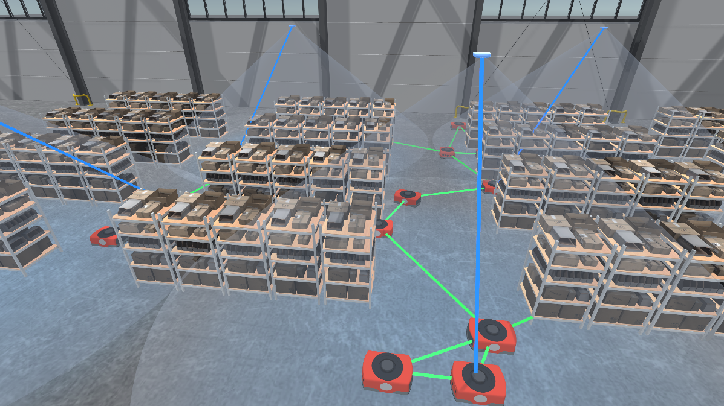
The 5G Atom concepts: Combination of multi-path and mesh communication system in an Industry 4.0 environment

Slide 24
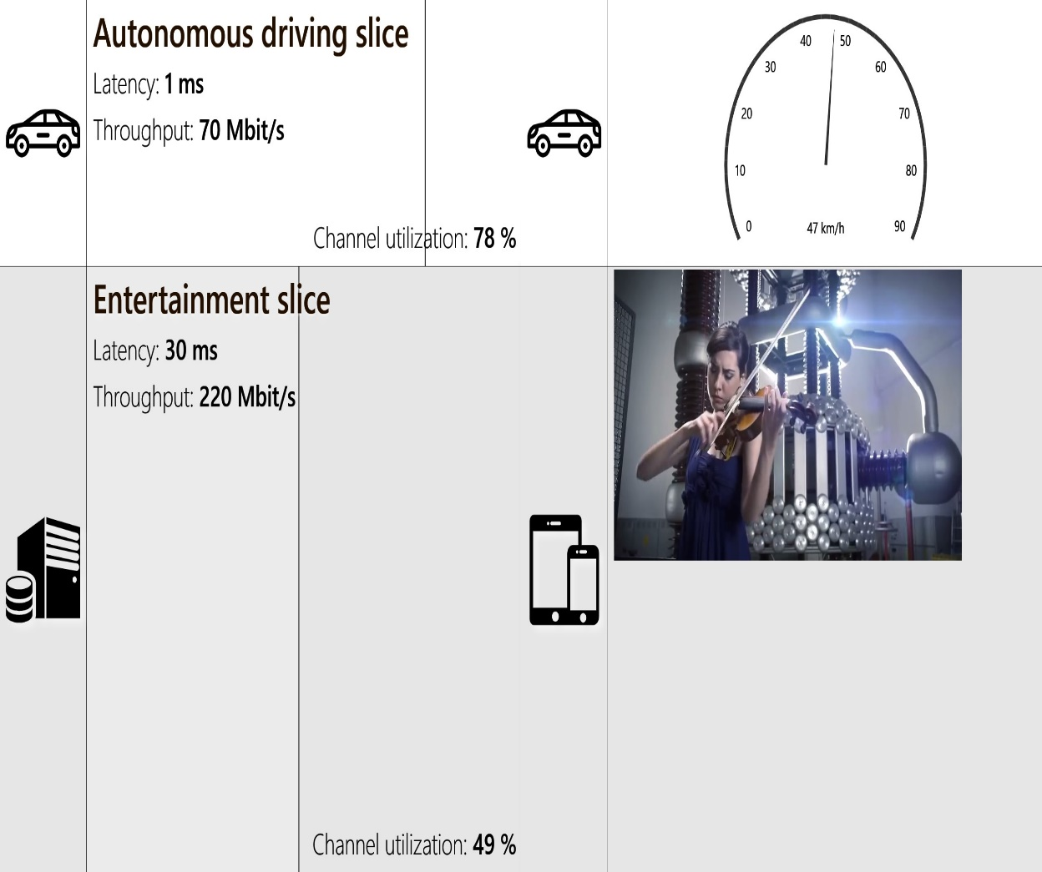
The 5G Atom concepts: Network slicing

Slide 25
The 5G Atom concepts: Hierarchical Mobile Edge Cloud (MEC)

Slide 26
Softwarization: The Game Changer for Network Operators

Slide 27
The 5G Atom game changer: Softwarization in the cloud and in mobile devices

Slide 28
The 5G Atom game changer: Softwarization future

