Slide 1
Docker: Containerize your Application
Chapter 12
Computing on Communication Networks Fitzek/Granelli/Seeling
Alexander Kropp, Roberto Torre

Slide 2
Introduction to Docker

Slide 3
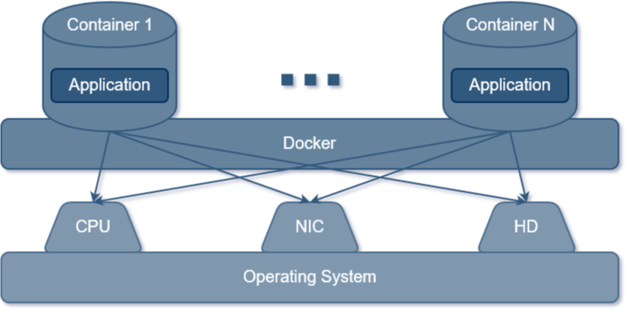
Virtualization with containers

Slide 4
Containers vs. Virtual Machines

Slide 5
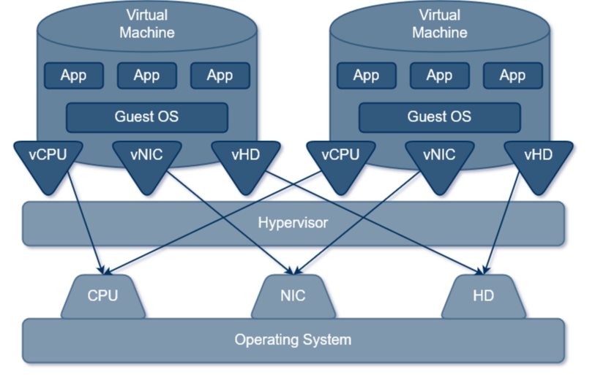
Virtualization with VMs

Slide 6
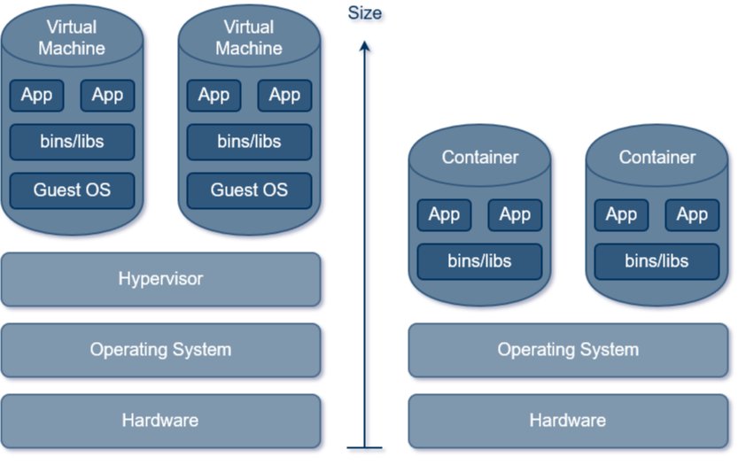
Size comparison between VMs and containers

