Slide 1
Standardization Activities for Future Communication Networks
Chapter 2
Computing on Communication Networks Fitzek/Granelli/Seeling
Fabrizio Granelli, Patrick Seeling, Frank H.P. Fitzek and Riccardo Bassoli

Slide 2
Introduction

Slide 3
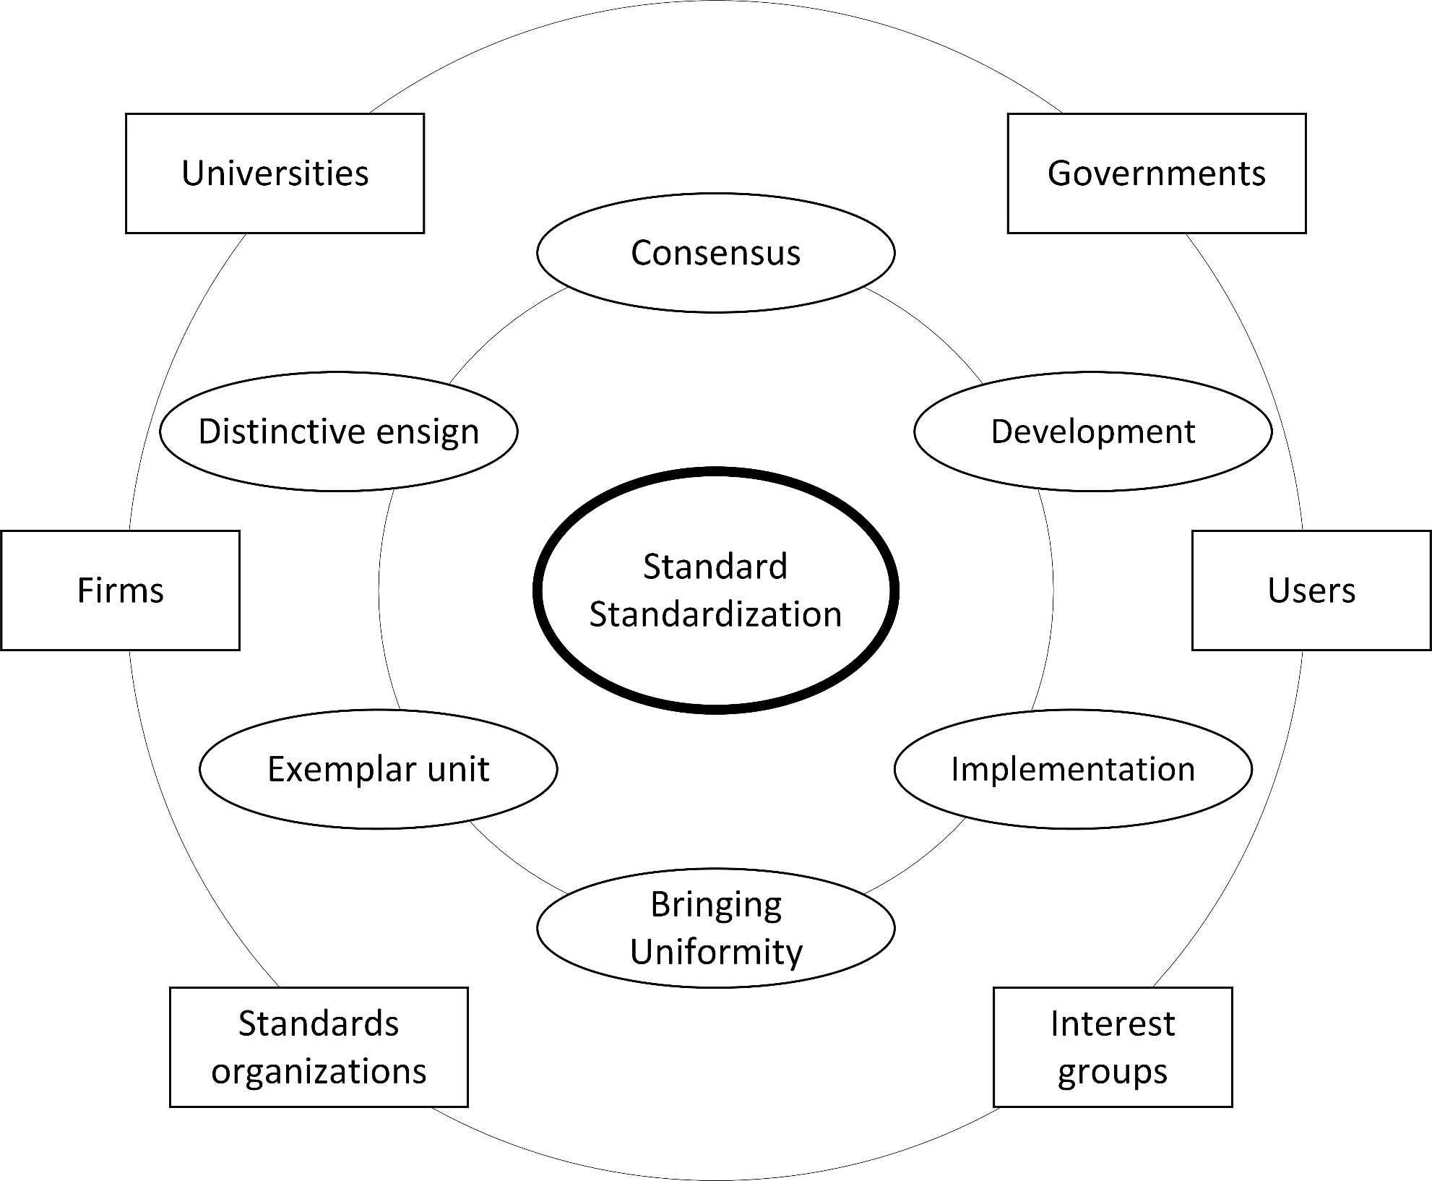
Main aspects behind standardization (internal ring) and main entities currently involved in standardization activities (external ring).

Slide 4
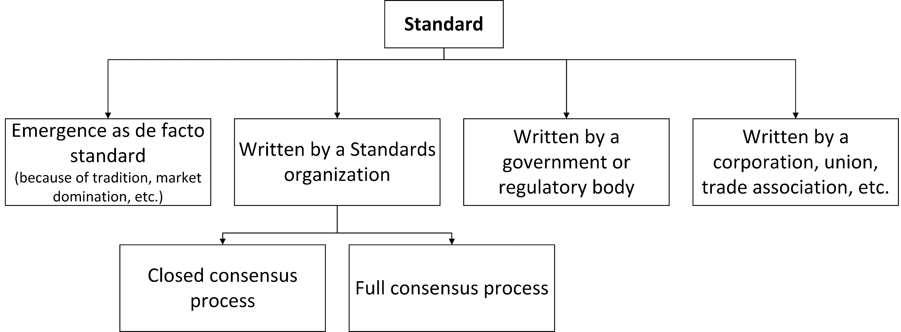
Taxonomy of procedures of standardization

Slide 5
Standardization of Future Generation networks

Slide 6
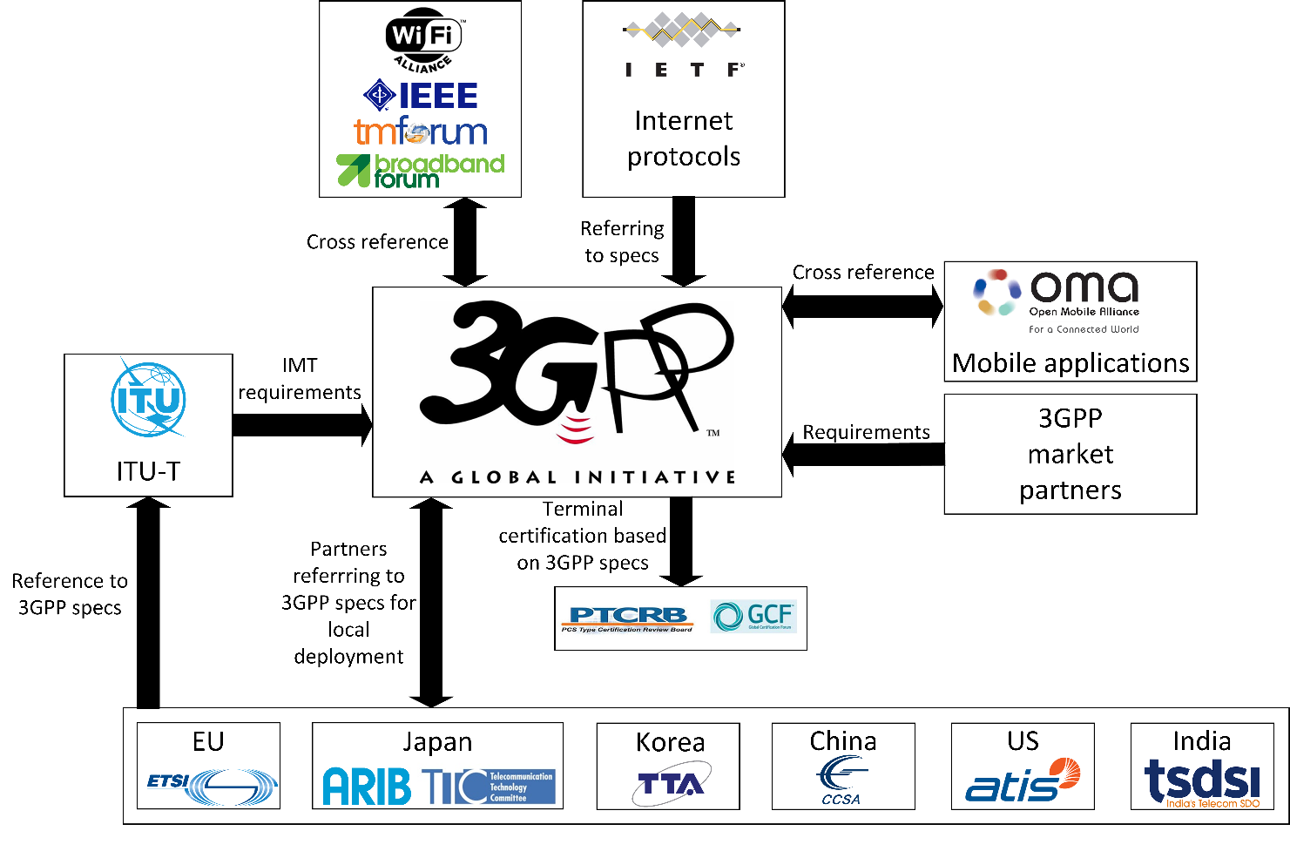
Taxonomy of 5G standardization activities

Slide 7
3GPP Standardization

Slide 8
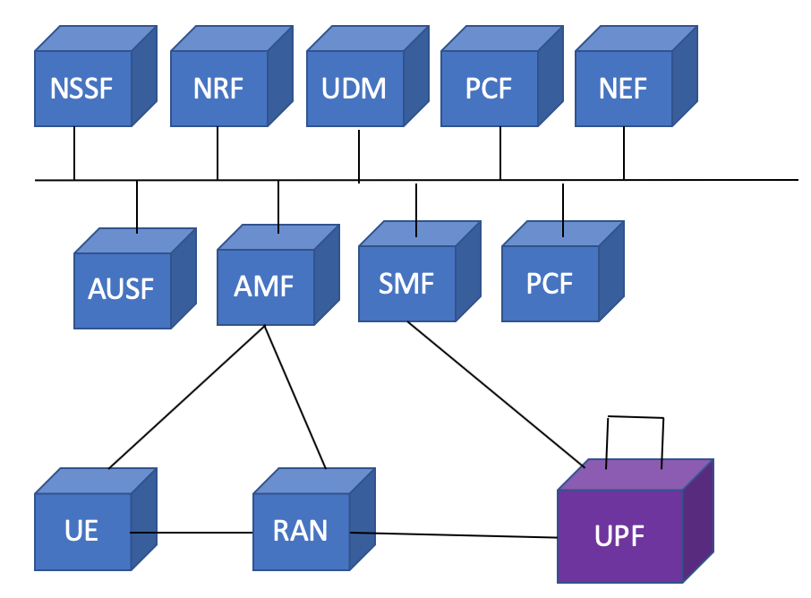
The 3GPP 5G Service-Based Architecture

Slide 9
ETSI Standardization

Slide 10
MSEC deployment in the 5G architecture as proposed by ETSI

Slide 11
ITU-T Standardization

Slide 12
Network slice instance information model

Slide 13
IETF/IRTF Standardization

Slide 14
Network slice management in the ETSI NFV model

