Slide 1
Software-Defined Networks
Chapter 6
Computing on Communication Networks Fitzek/Granelli/Seeling
Justus Rischke and Hani Salah

Slide 2
THE ROAD TO SDN

Slide 3
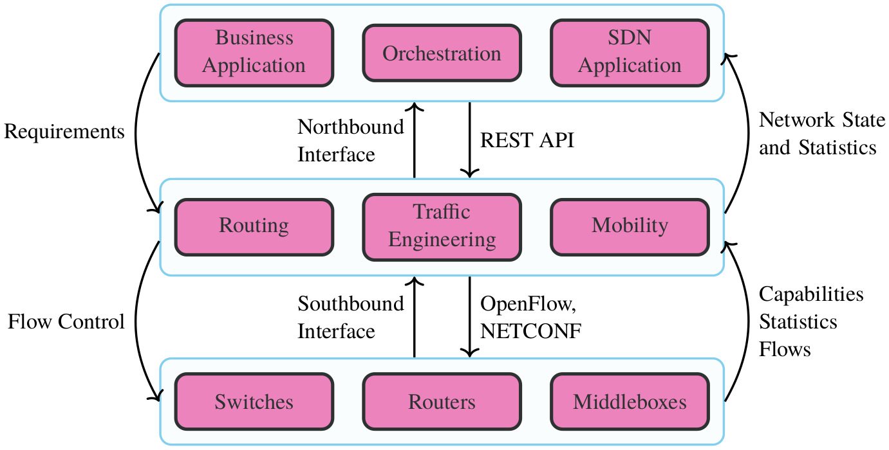
SDN architecture overview

Slide 4
SDN USE CASES

Slide 5
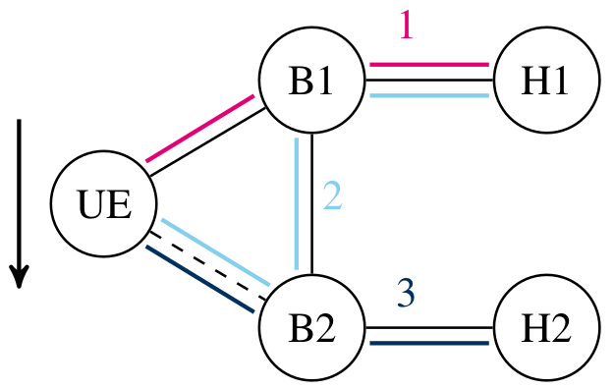
Handover scenario

Slide 6
TECHNOLOGIES AND STANDARDS

Slide 7
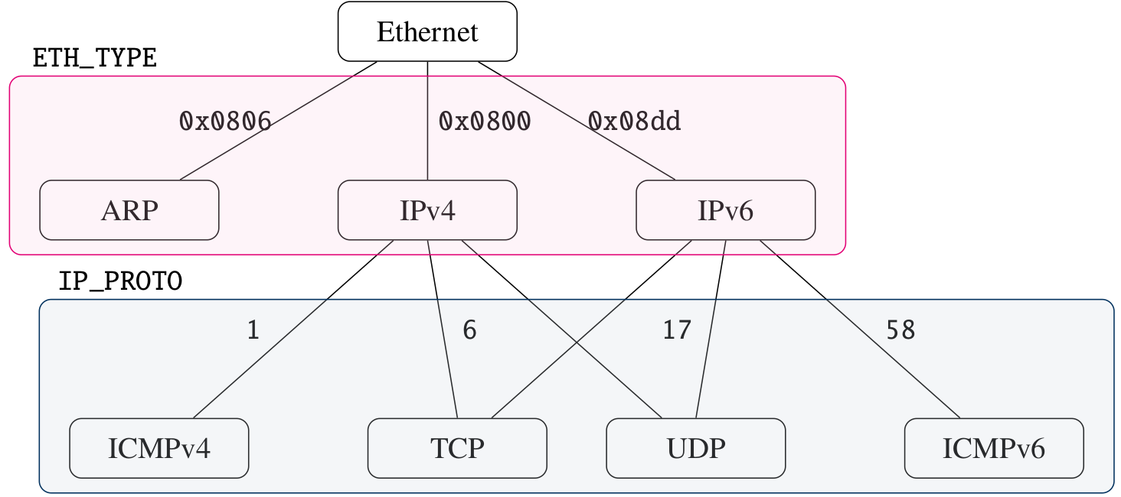
Dependencies of classifiers per layer

Slide 8
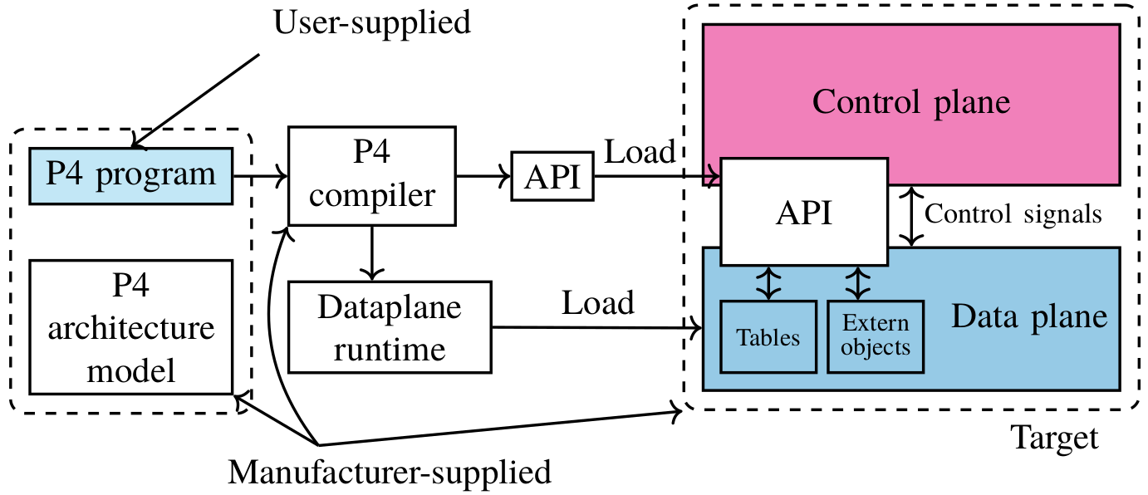
Programming of network devices with P4

Slide 9
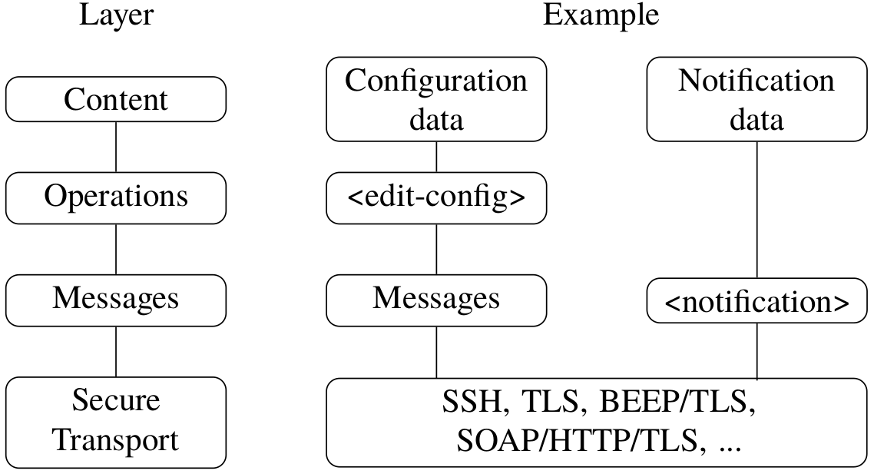
NETCONF protocol layers

