Slide 1
Network Coding for Transport
Chapter 20
Computing on Communication Networks Fitzek/Granelli/Seeling
Justus Rischke and Zuo Xiang

Slide 2
Introduction

Slide 3
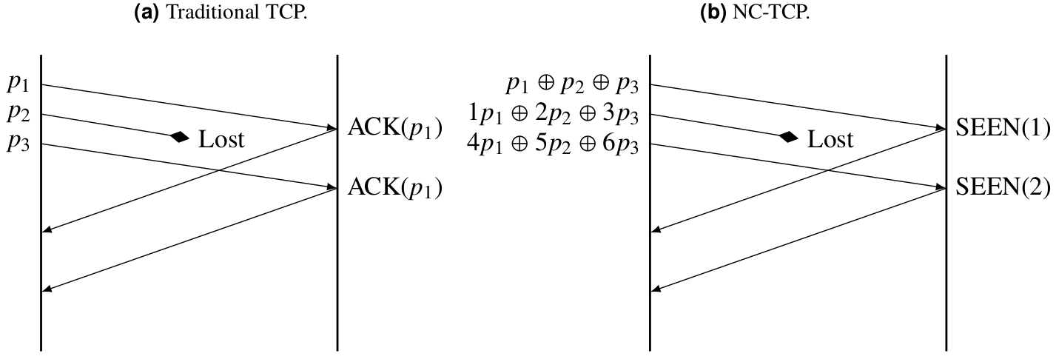
Difference between traditional TCP and NC-TCP

Slide 4
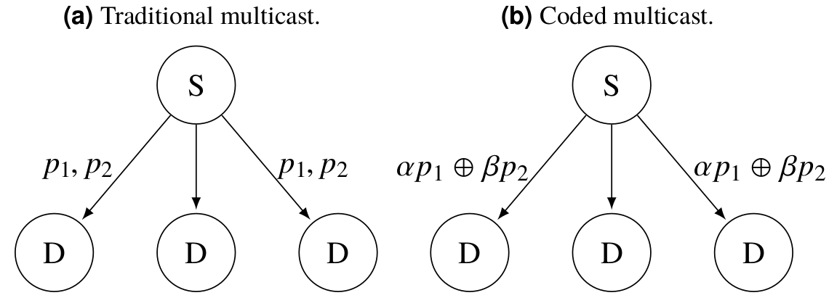
Difference between traditional multicast and coded multicast

Slide 5
NETWORK CODING AS
VIRTUALIZED NETWORK FUNCTION

Slide 6
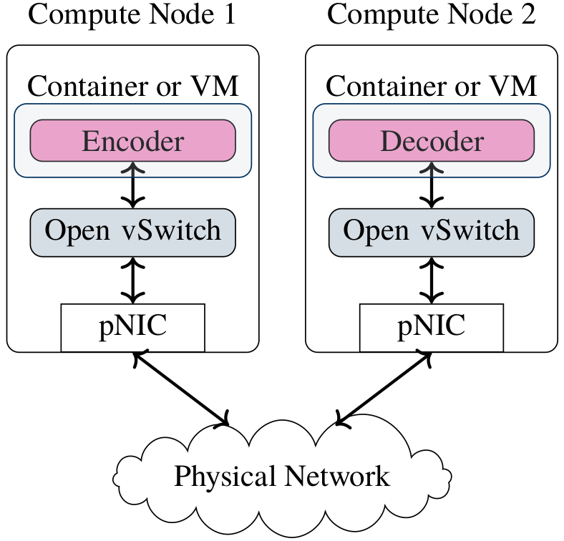
Virtualized encoder and decoder on general purpose compute nodes

Slide 7
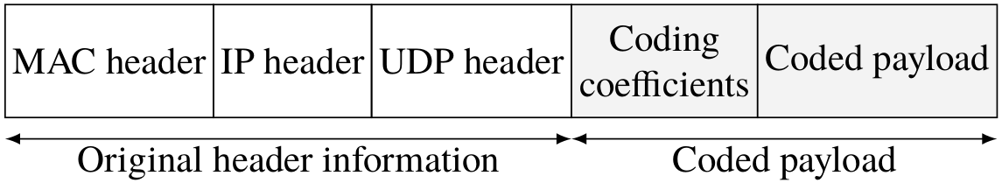
Coded UDP packet structure

Slide 8
MULTIHOP RECODING EXAMPLE

Slide 9
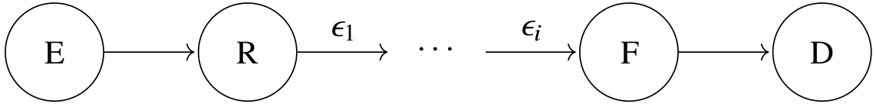
RLNC recoder in a multihop network

Slide 10
ADAPTIVE REDUNDANCY EXAMPLE

Slide 11
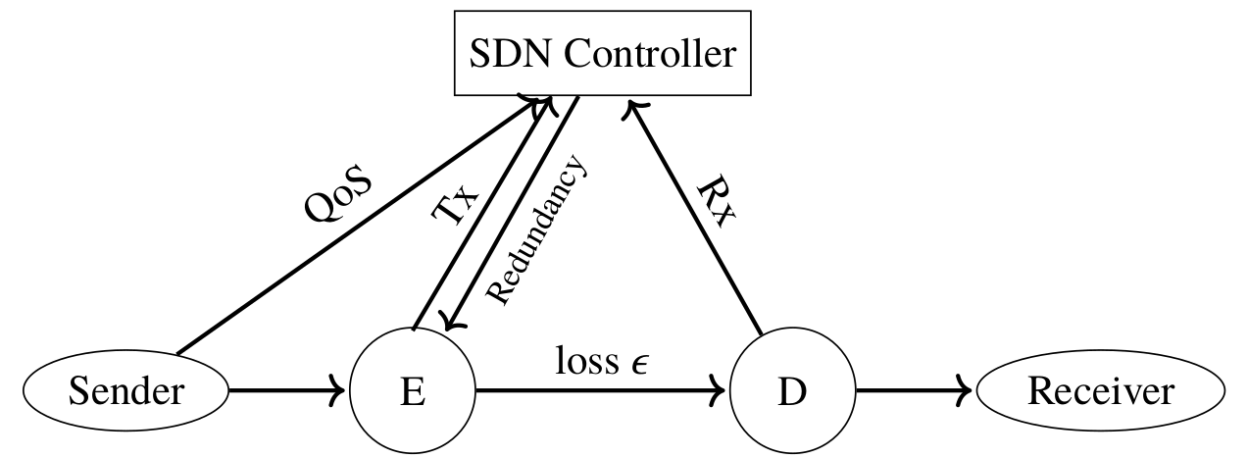
The SDN controller measures losses in the network and adapts redundancy according to desired QoS

Slide 12
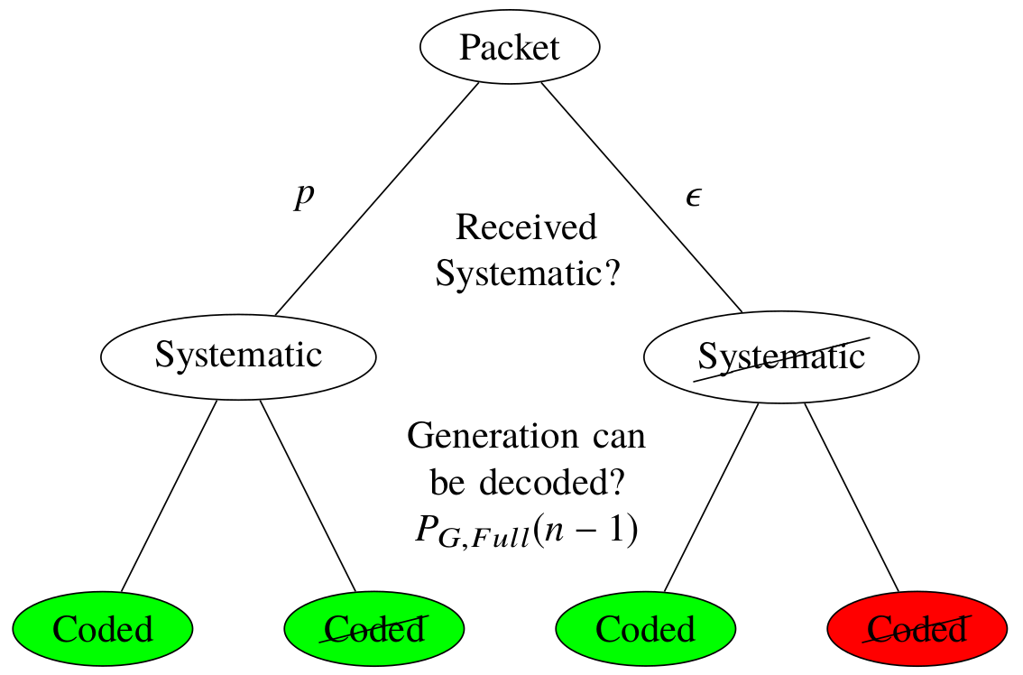
Tree diagram of decoding probability with systematic coding

Slide 13
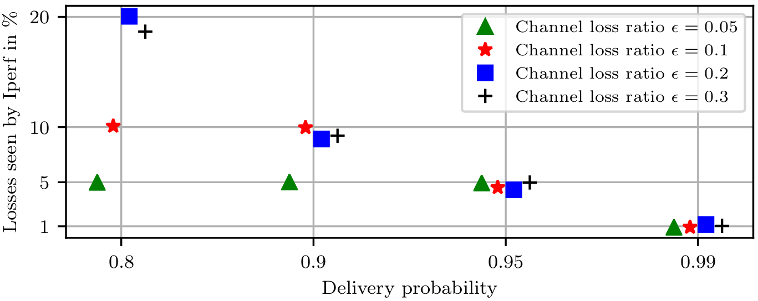
Losses seen by the application layer (e.g., Iperf )

