Slide 1
Integrating Software-Defined Radios
Chapter 26
Computing on Communication Networks Fitzek/Granelli/Seeling
Javier Acevedo, Marian Ulbricht, Dongho You

Slide 2
Introduction

Slide 3
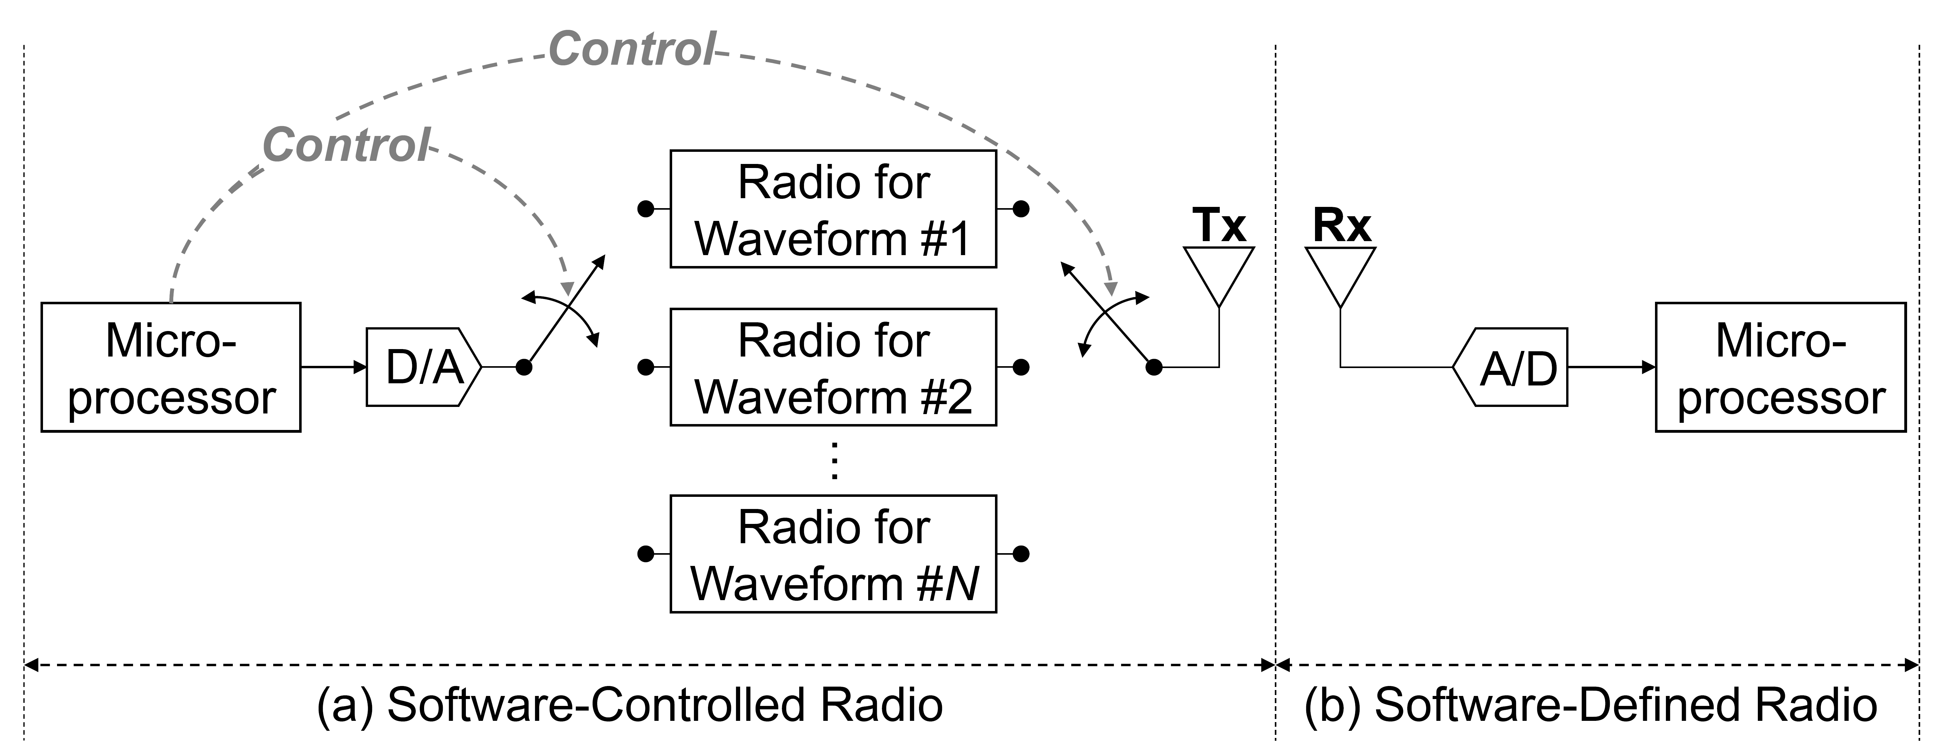
What is Software-Defined Radio (SDR)?

Slide 4
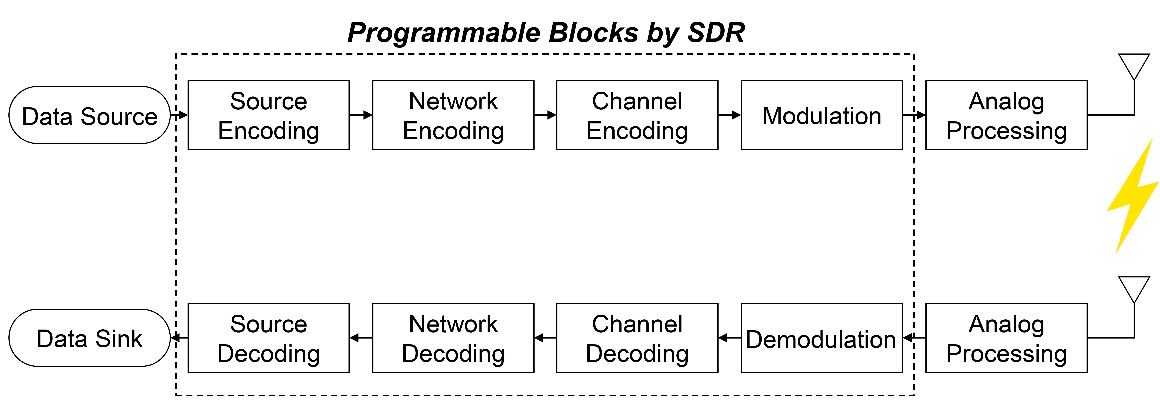
What is programmable in SDR?

Slide 5
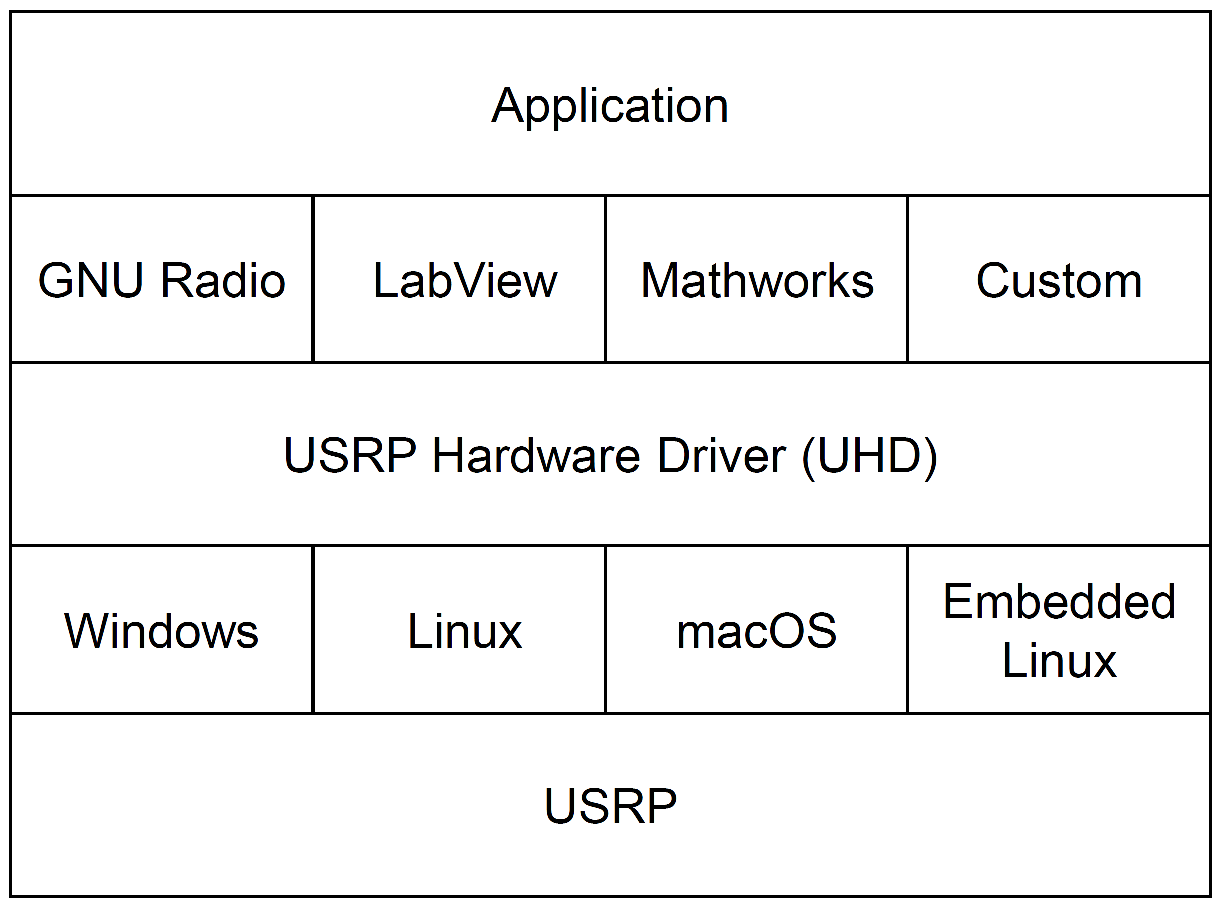
Software Stack for SDR

Slide 6
GNU Radio: Development Framework

Slide 7
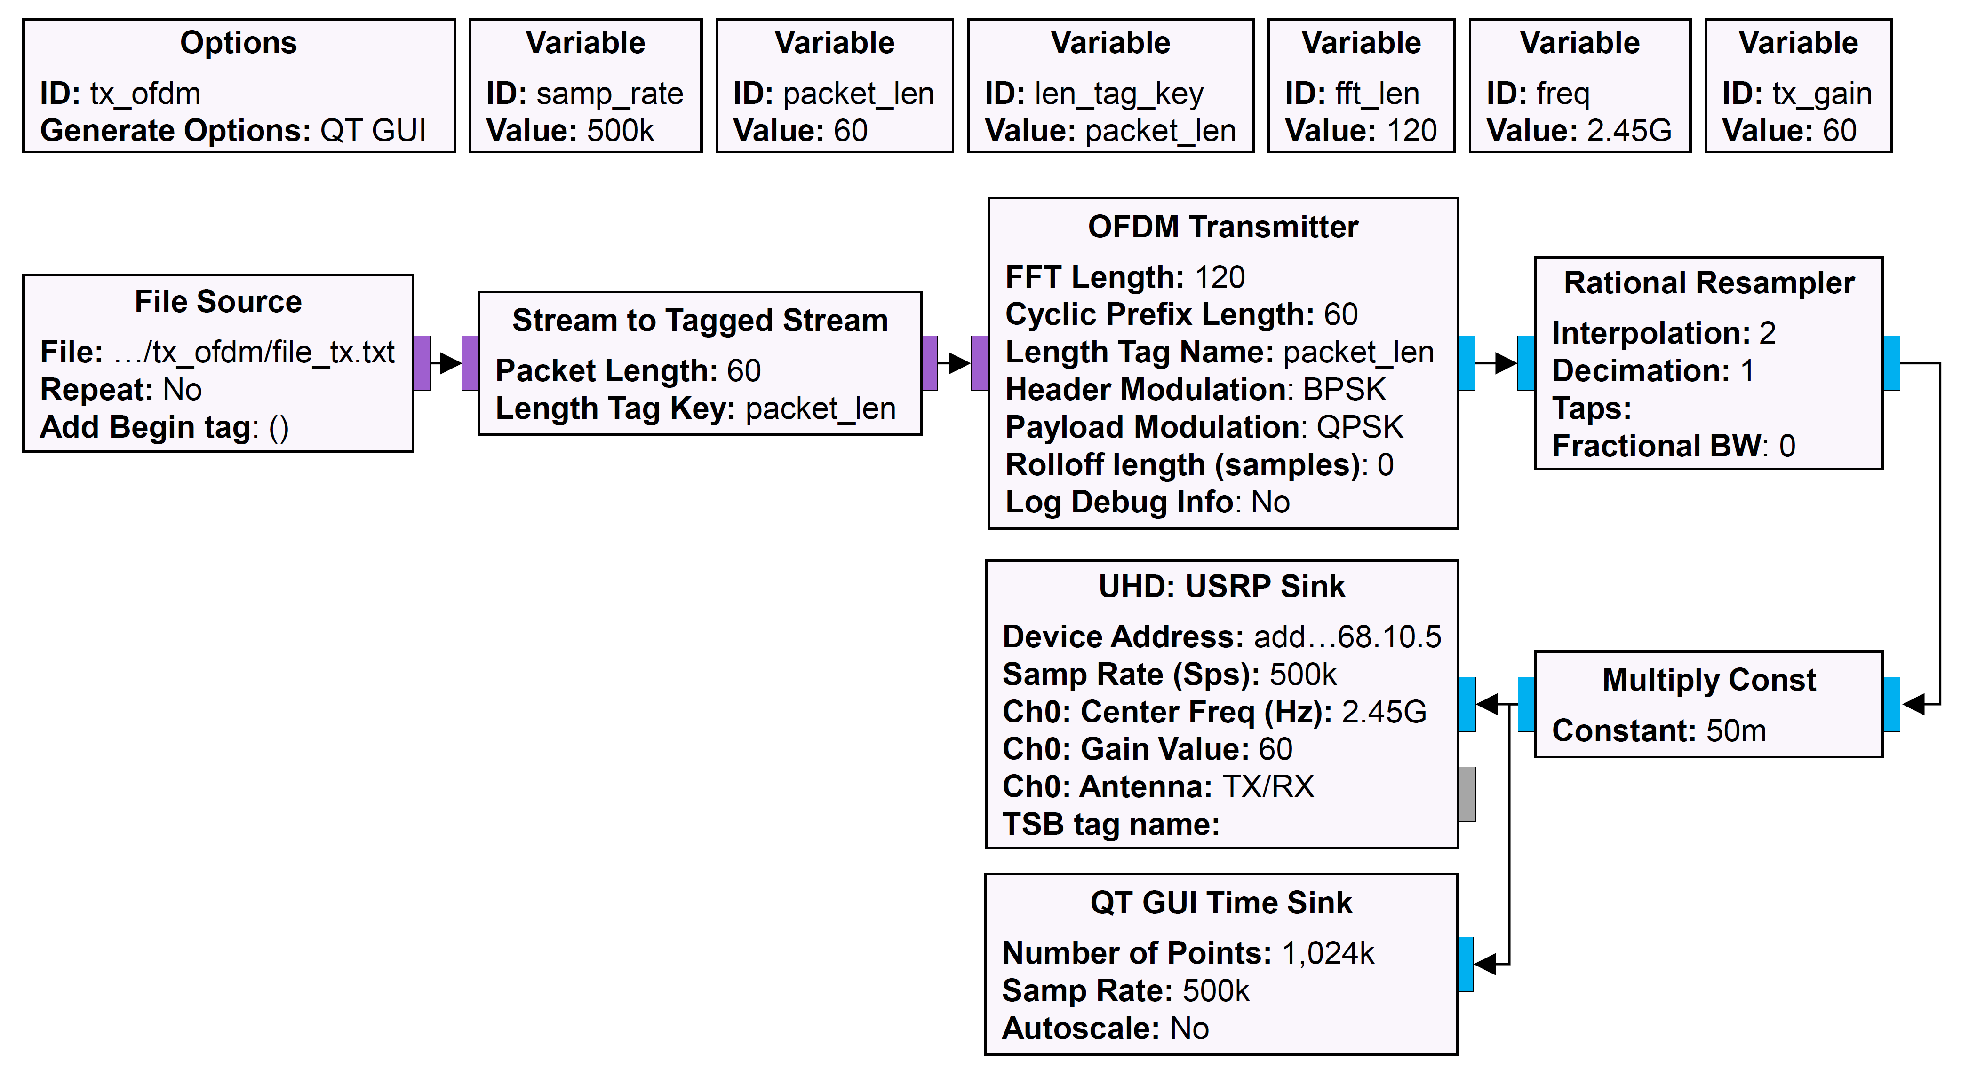
GNU Radio: OFDM Transmitter

Slide 8
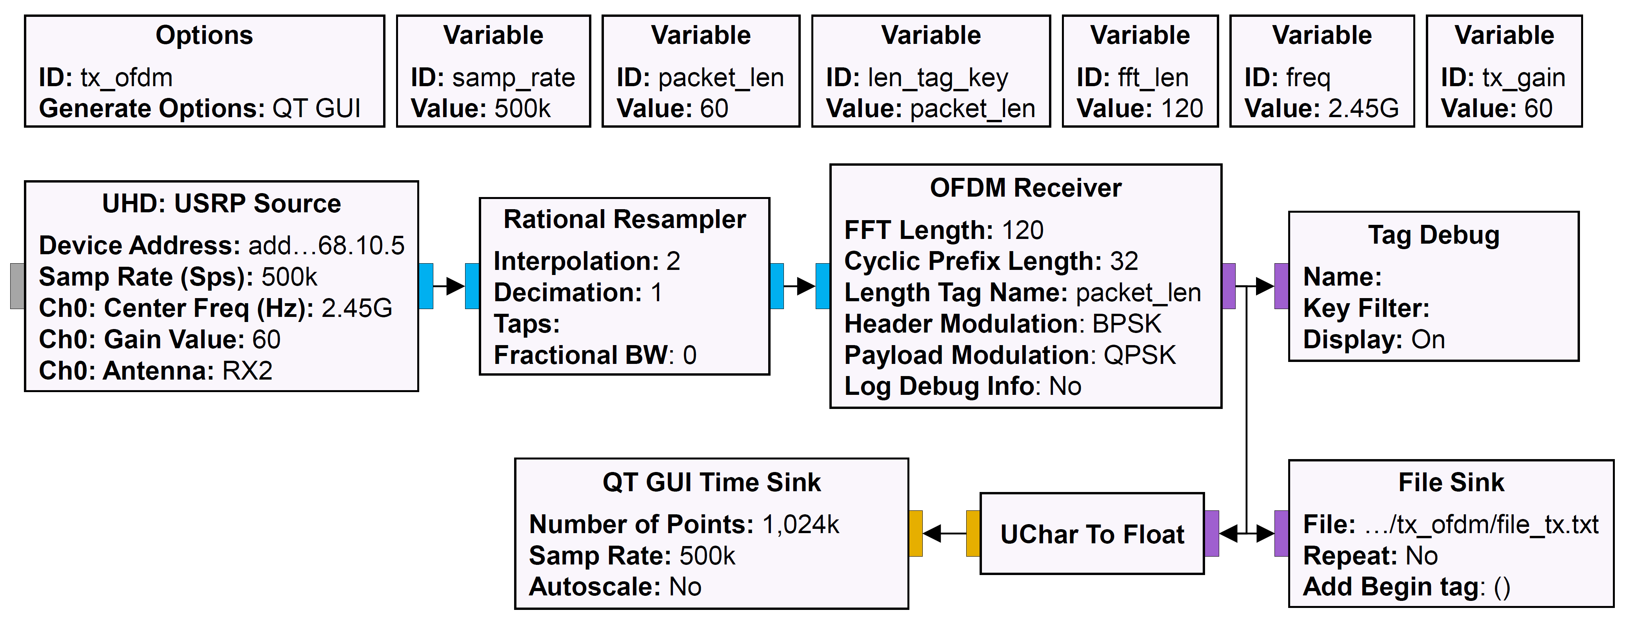
GNU Radio: OFDM Receiver

Slide 9
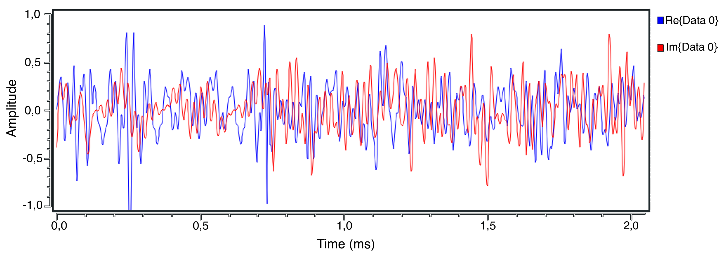
GNU Radio: Transmitted Output Signal

Slide 10
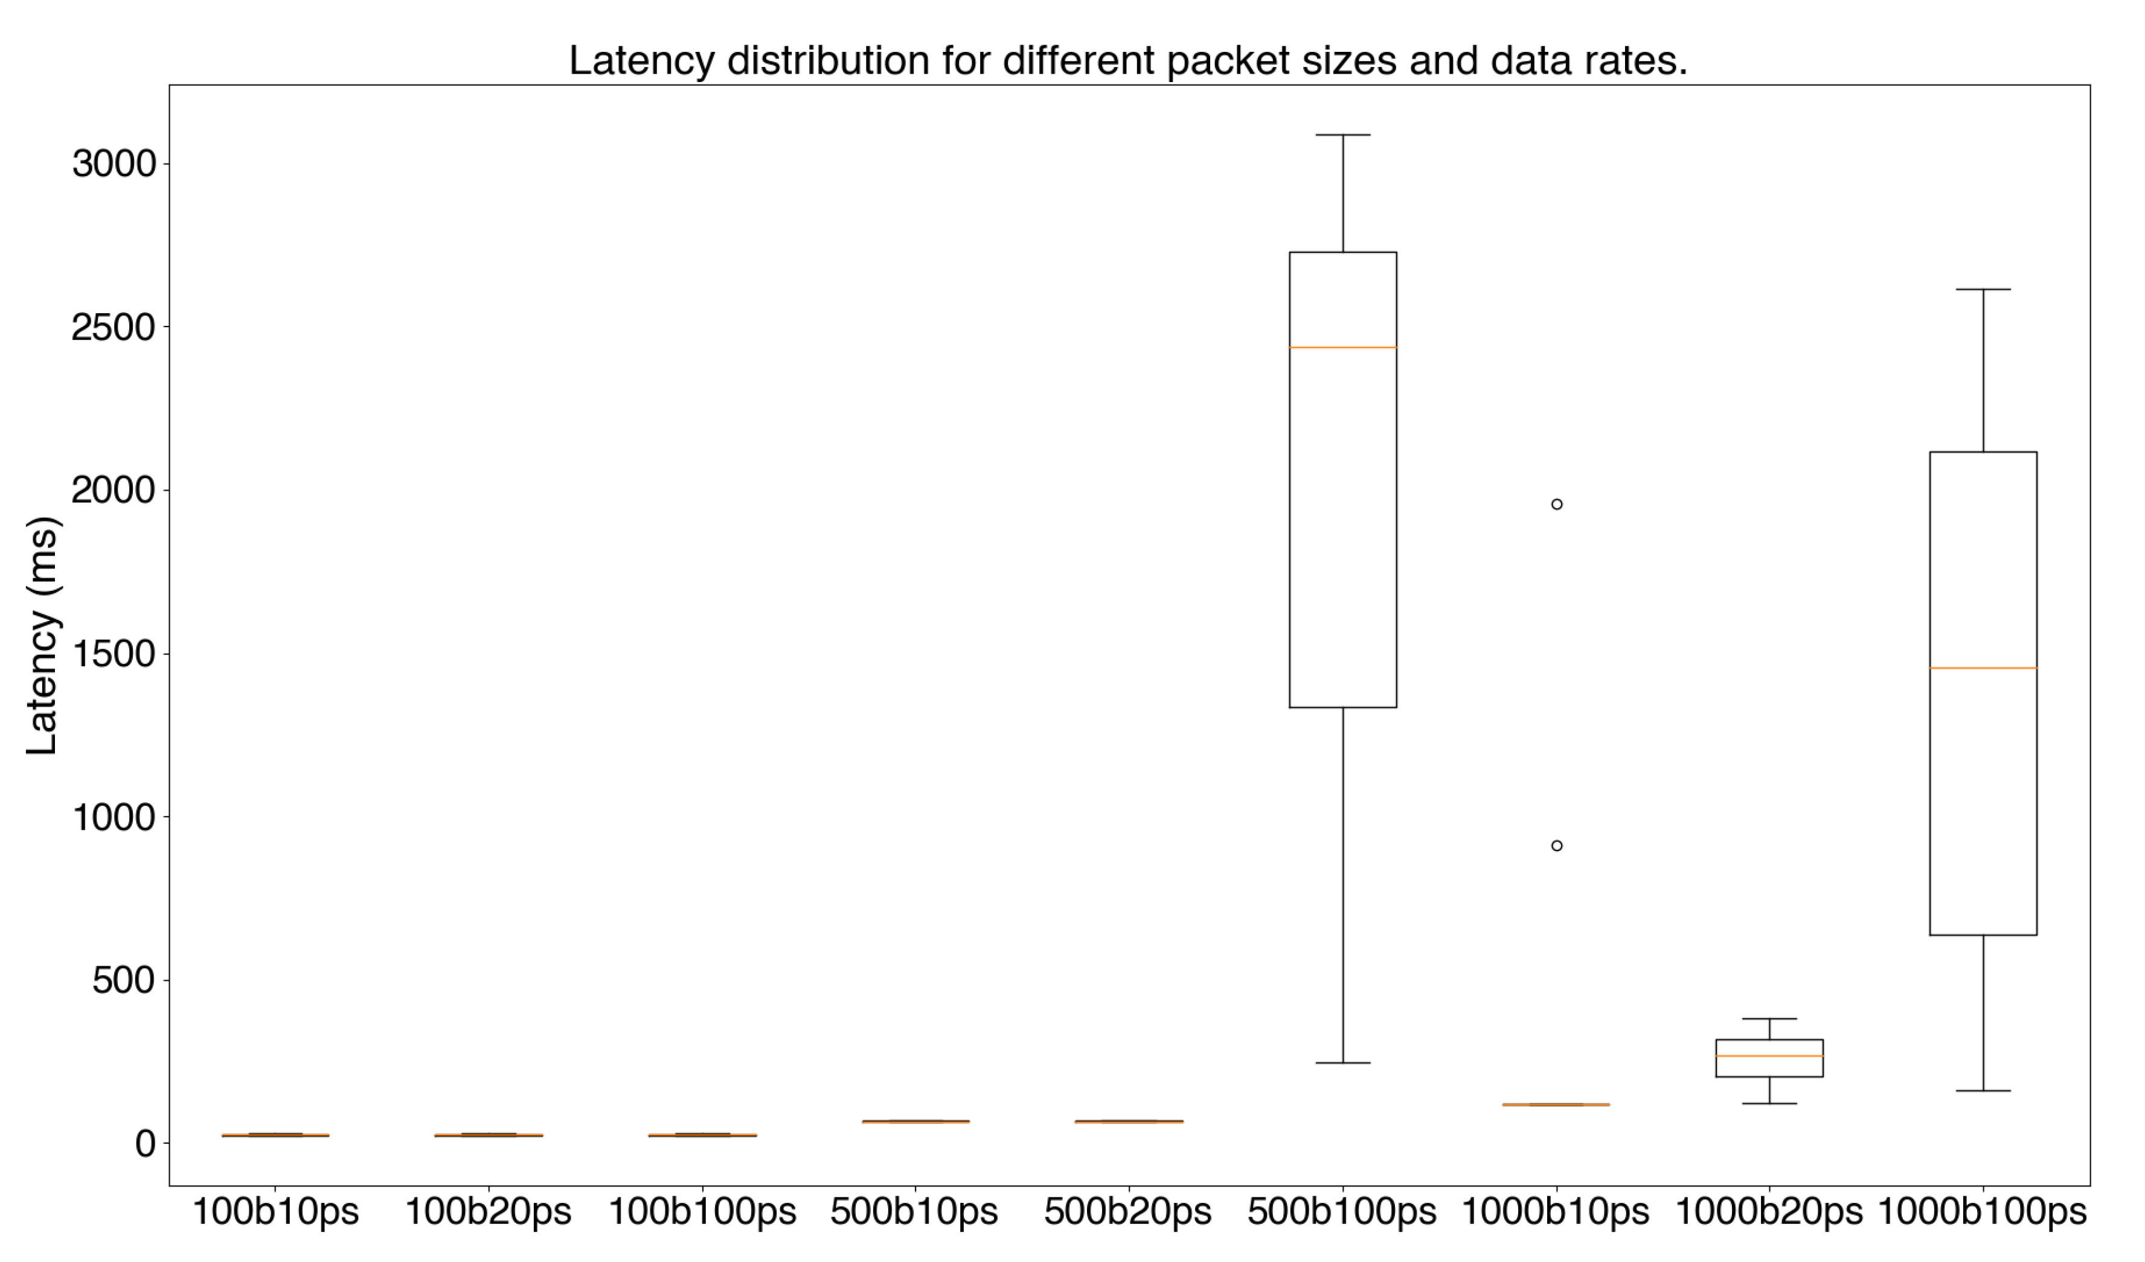
Latency Distribution for Different Packet Sizes and Data Rates

