Slide 1
Chapter 18
Computing on Communication Networks Fitzek/Granelli/Seeling
Machine Learning for Congestion Control
Christian Vielhaus

Slide 2
Introduction
Goals of sender-side congestion control algorithms (there are more):
Find a sending rate that utilizes the path capacity (critical factor: bottleneck link rate)
Minimize queuing delay along the path
Share bottleneck bandwidth fairly with others

Slide 3
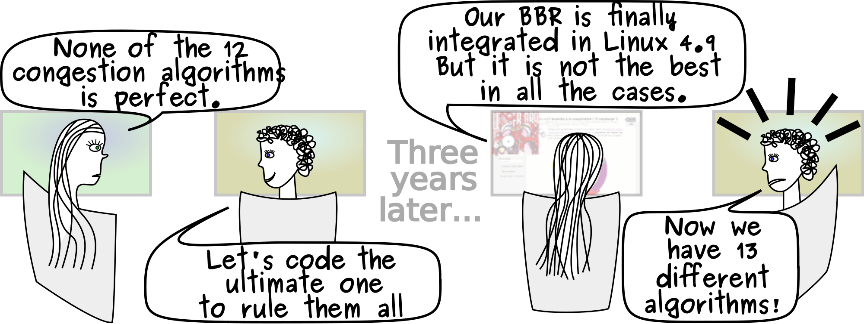
Why machine learning?
No manually designed algorithm is perfect. Can ML help? [1]

Slide 4
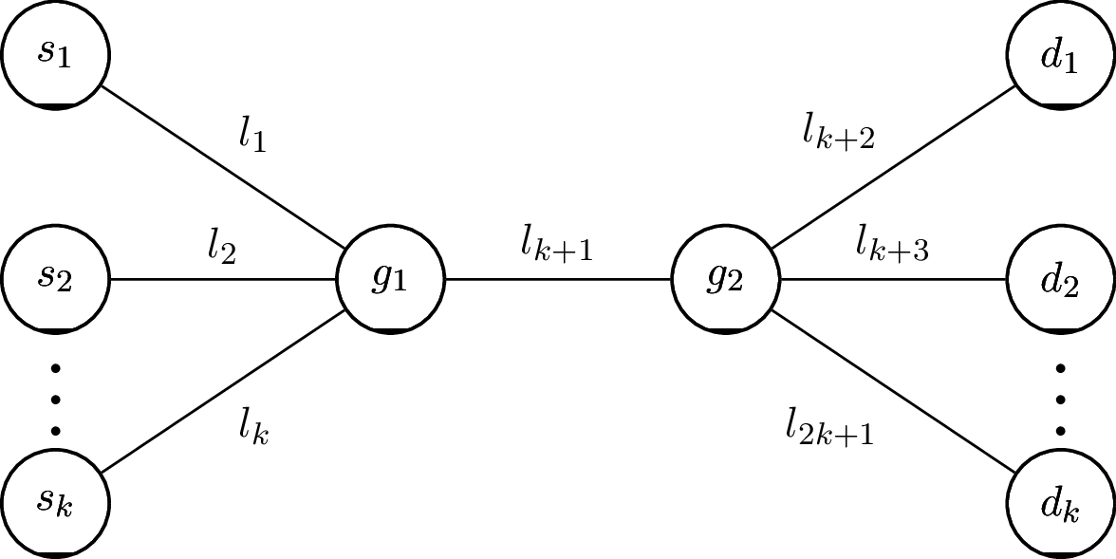
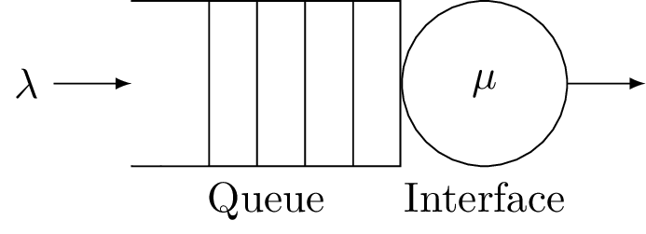
Congestion occurs at the bottleneck!
Packet flows

Slide 5
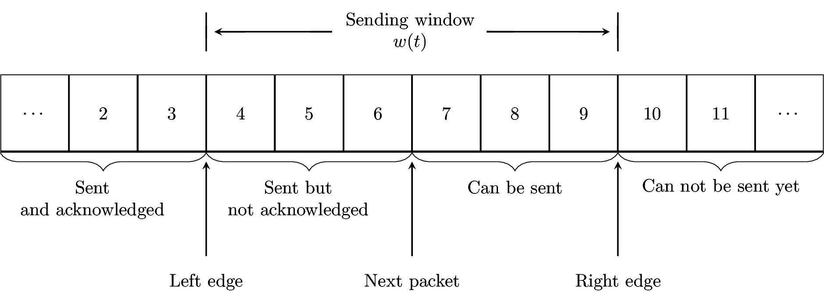
Congestion window limits the packets in flight

Slide 6
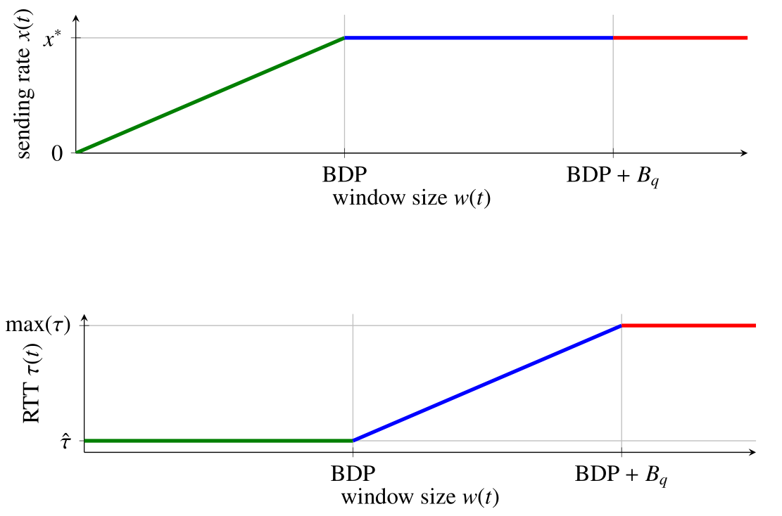
Kleinrock point of optimality
BDP: bandwidth-delay product
Bq: Buffer size at bottleneck queue

Slide 7
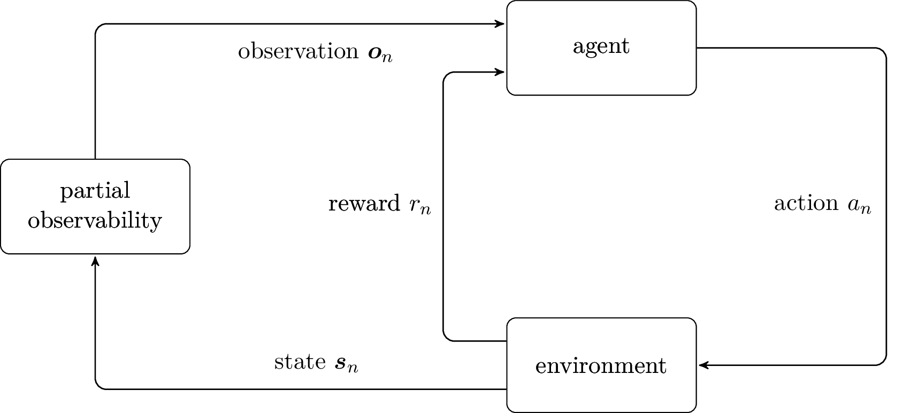
Agent design
Observations: a history of sending rate, throughput, latency and loss rate signals (anything that can be observed or deduced)
Rewards: maximize throughput, minimize latency and loss rate
Actions: adjust congestion window size

Slide 8
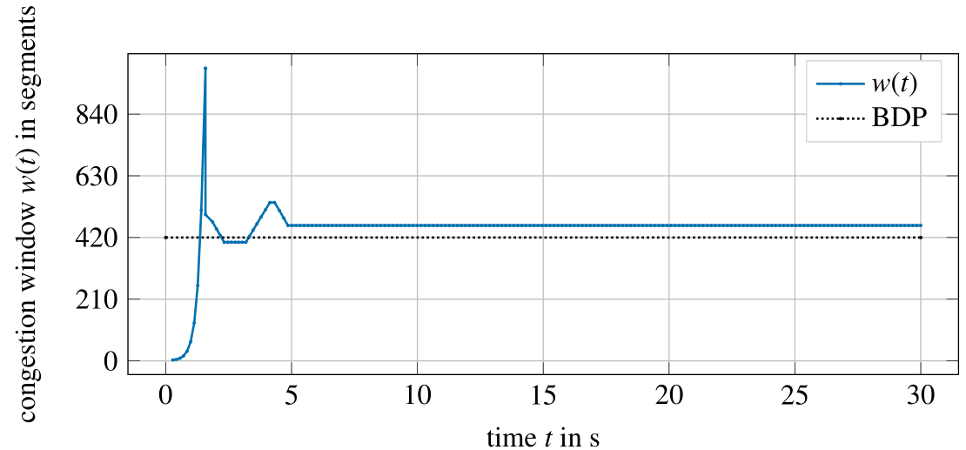
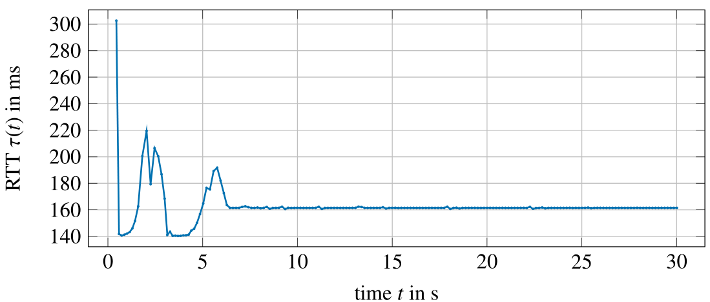
Testing on a path with a single source
BDP = 420 segments
Propagation delay = 140ms

Slide 9
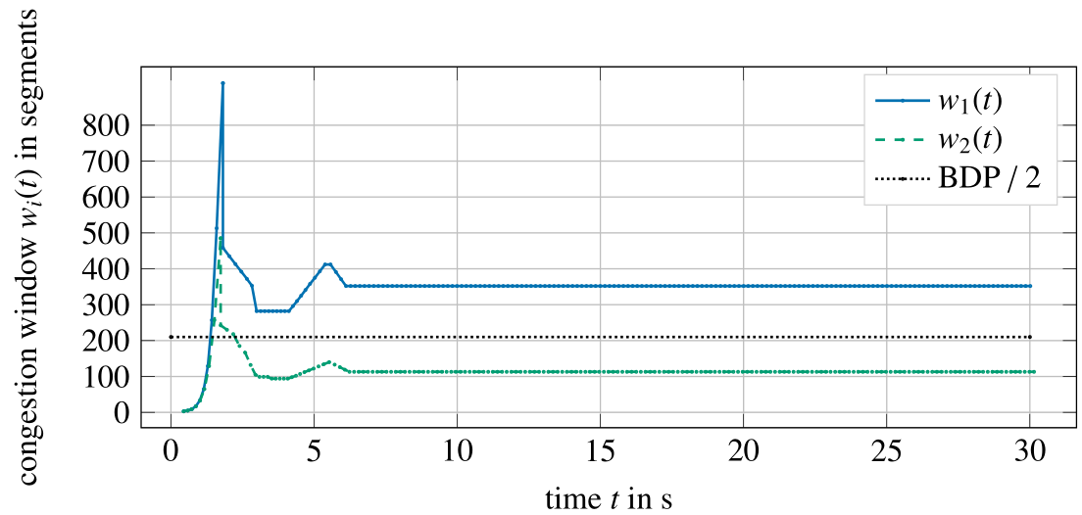
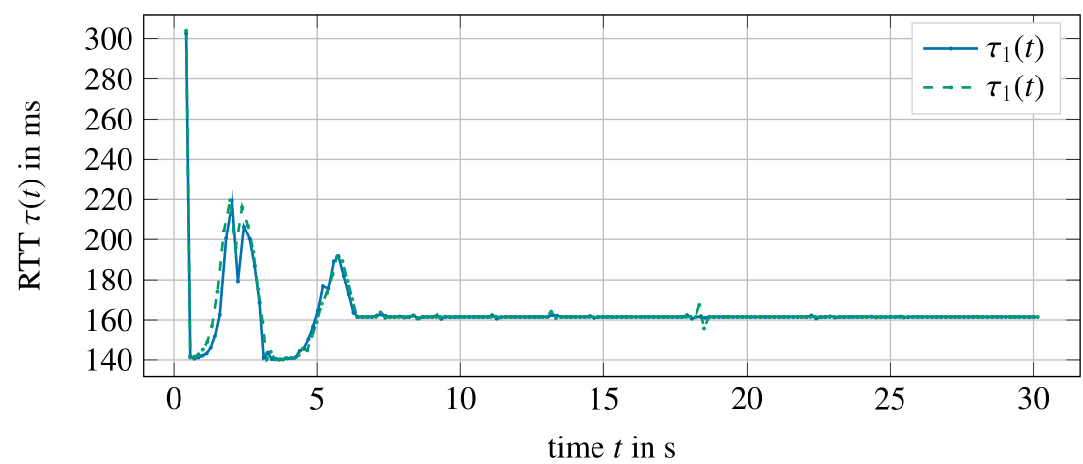
What about competition?
Flows do not share the BDP fairly

Slide 10
Sources
[1]: https://commons.wikimedia.org/wiki/File:Comic strips Linux BBR.svg

