Slide 1
Chapter 23
Computing on Communication Networks Fitzek/Granelli/Seeling
Security for Mobile Edge Cloud
Simon Hanisch, Amr Osman, Tao Lin and Thorsten Strufe

Slide 2
Network Segmentation

Slide 5
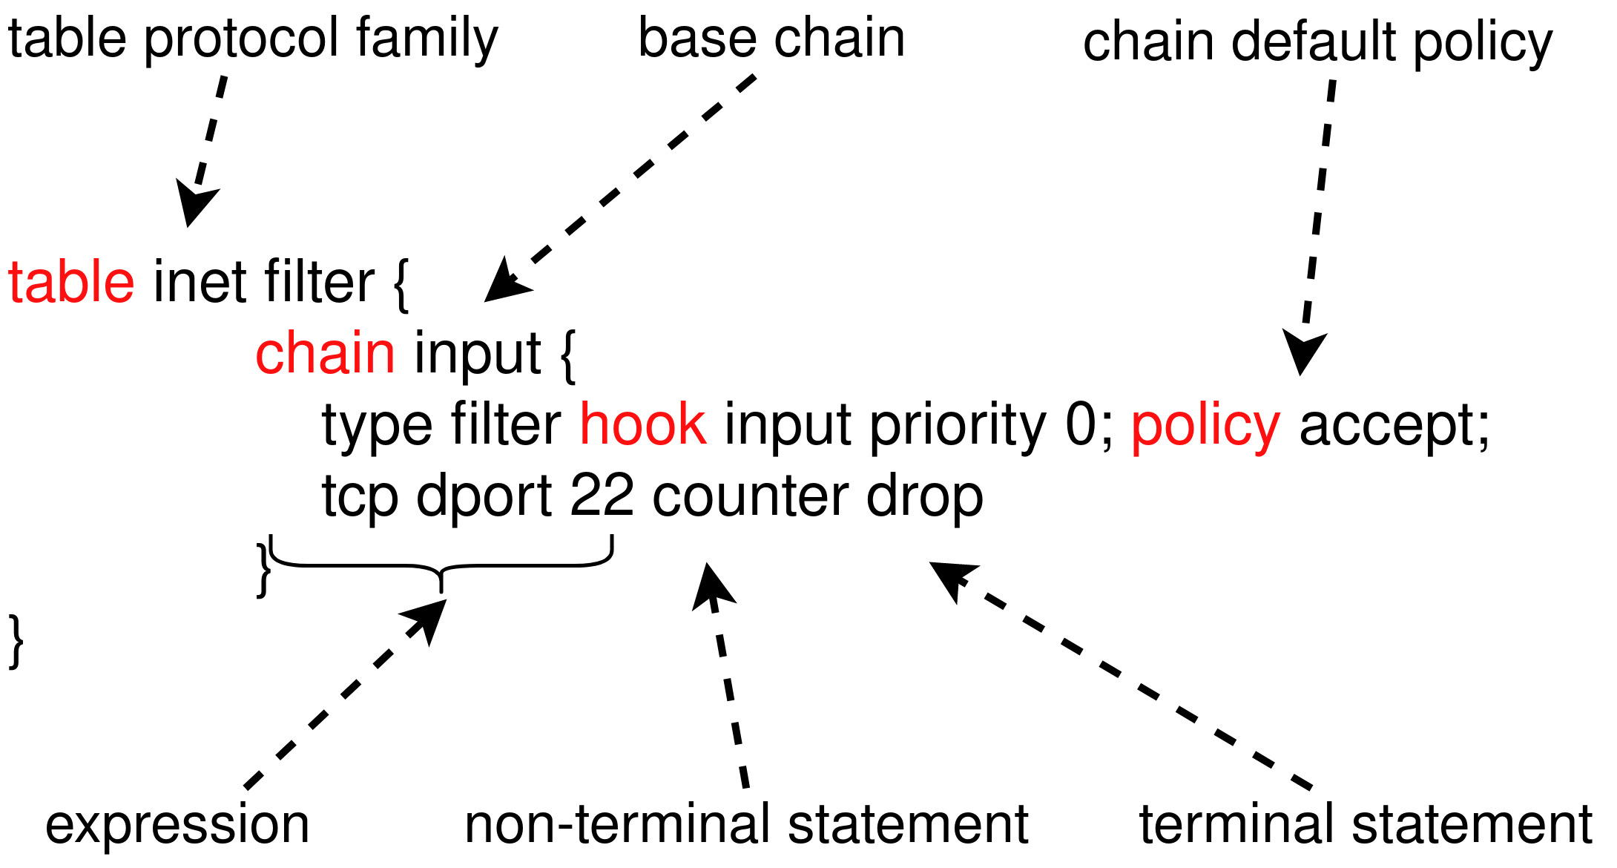

Slide 6
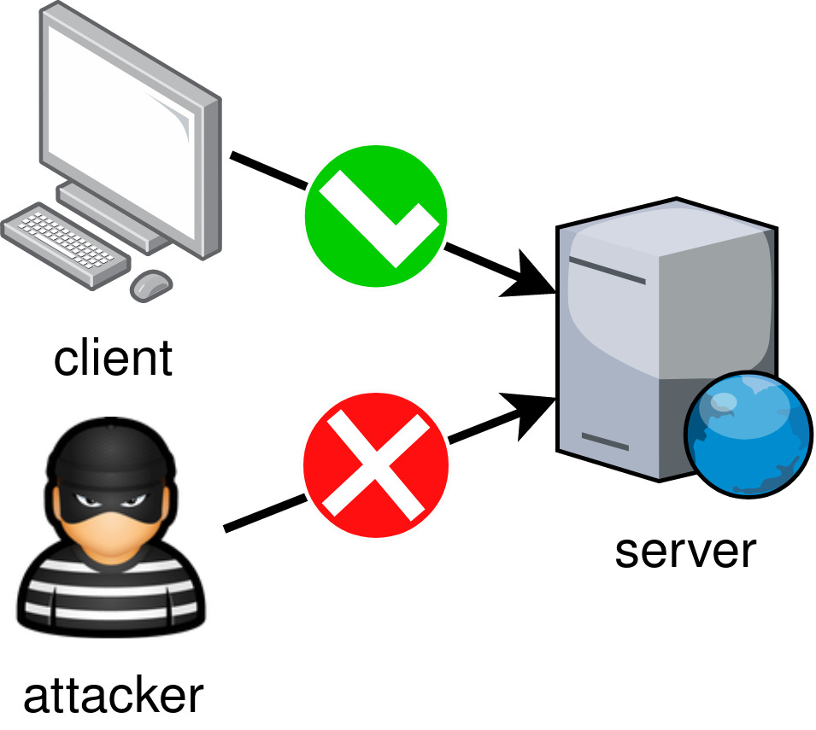

Slide 7
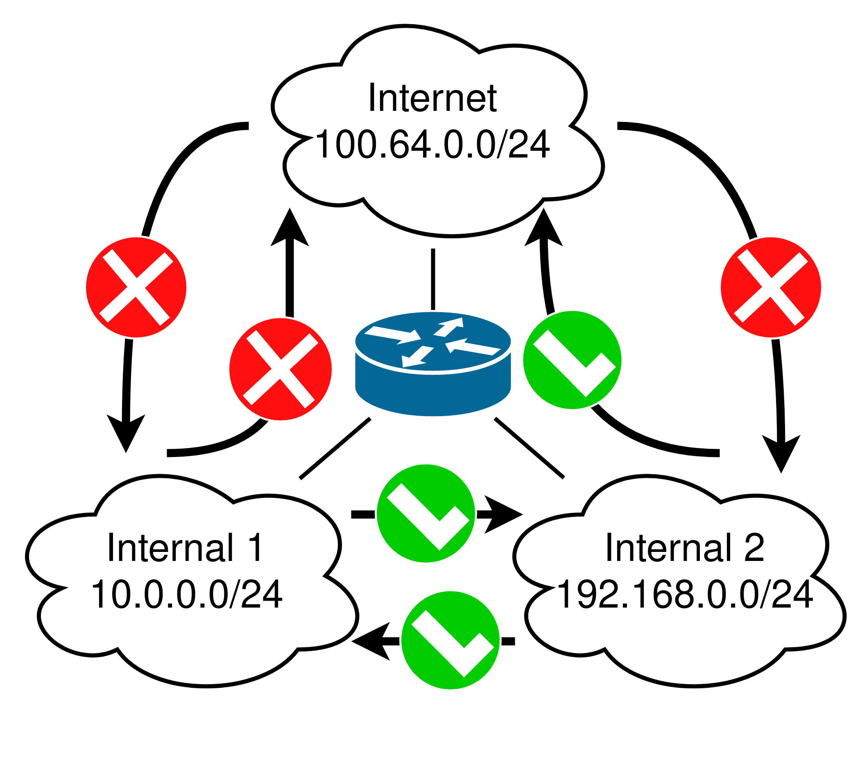

Slide 8
Secure Network Tunnels

Slide 10
